Slide 1
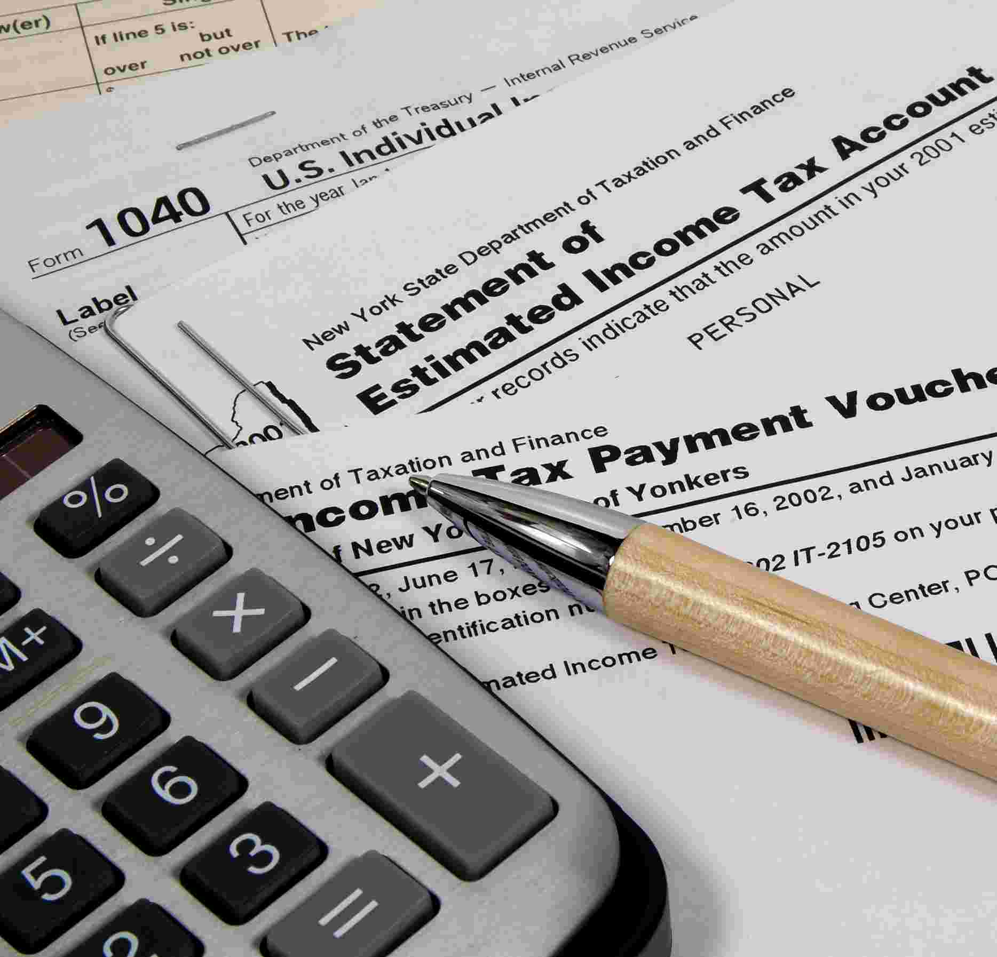
A New Tax proposal
Sabrina Walker & Robert Watkins

Slide 2
A Comparison Between Codes
Existing Code (2013)
Proposed Code
Filing Status: Single
If your taxable income is between… | Your tax bracket is…
$0 and $8,925 | 10%
$8,925 and $36,250 | 15%
$36,250 and $87,850 | 25%
$87,850 and $183,250 | 28%
$183,250 and $398,350 | 33%
$398,350 and $400,000 | 35%
$400,000 and above | 39.6%
Tax brackets will be divided into more brackets
Shown on next slide

Slide 3
Filing Status: Single
If your filing status is between…
$0 and $4,465 | 8%
$4,465 and $8,925 | 10%
$8,925 and $18,125 | 13%
$18,125 and $36,250 | 15%
$36,250 and $43,925 | 23%
$43,925 and $87,850 | 25%
$87,850 and $91,625 | 26%
$91,625 and $183,250 | 30%
$183,250 and $199,175 | 37%
$199,175 and $250,350 | 38%
$250,350 and $300,000 | 39%
$300,000 and $400,000 | 40%
$400,000 and above | 43%

Slide 4
A Comparison of the Two Codes: $10,000 Taxable Income
Current Code
Proposed Code
Average rate: 12.5%
Taxes paid:
$1,250
Average rate: 10.33%
Taxes paid:
$1,033.33
Money saved:
$216.67

Slide 5
A Comparison of the Two Codes: $50,000 Taxable Income
Current Code
Proposed Code
Average Rate: 16.67%
Taxes paid:
$8,335
Average Rate:
15.67%
Taxes paid:
$7,835
Money saved:
$500

Slide 6
A Comparison of the Two Codes: $120,000 Taxable Income
Current Code
Proposed Code
Average rate:
19.5%
Taxes paid:
$23,400
Average rate:
18.75%
Taxes paid:
$22,500
Money saved:
$900

Slide 7
A Comparison of the Two Codes: $200,000 Taxable Income
Current Code
Proposed Code
Average rate:
22.2%
Taxes paid:
$44,400
Average rate:
22.5%
Taxes paid:
$45,000
Difference:
$600

Slide 8
A Comparison of the Two Codes: $260,000 Taxable Income
Current Code
Proposed Code
Average rate:
22.2%
Taxes paid:
$57,720
Average rate:
24%
Taxes paid:
$62,400
Difference:
$4,680

Slide 9
A Comparison of the Two Codes: $325,000 Taxable Income
Current Code
Proposed Code
Average rate:
22.2%
Taxes paid:
$72,150
Average rate:
25.33%
Taxes paid:
$82,322
Difference:
$10,172

Slide 10
A Comparison of the Two Codes: $410,000 Taxable Income
Current Code
Proposed Code
Average rate:
26.51%
Taxes paid:
$108,691
Average rate:
26.69%
Taxes paid:
$109,429
Difference:
$738

Slide 11
Old Taxes Compared With New Taxes
Taxes Paid ($)
Income

Slide 12
Revenue Reallocation
While any tax cuts will pay for themselves through raised taxes for higher incomes, some federally funded programs will be cut, in order to stabilize budget
Abstinence Education: $40,895,000 cut
Rural Telephone Loans and Loan Guarantees: $275,000,000 cut
Payments to Agricultural Experiment Stations Under the Hatch Act: $75,000,000 cut
Production Flexibility Payments for Contract Commodities: $2,000,000,000 cut
Program for Study of Eastern Europe and the Independent States of the Former Soviet Union: $5,000,000 cut

Slide 13
Lists of Works Cited
"Tax Brackets (Federal Income Tax Rates) 2000 through 2013." Tax Brackets (Federal Income Tax Rates) 2000 through 2013. N.p., n.d. Web. 18 Mar. 2013.
"List of US Federal Government Funding Programs." Idilogic. Idilogic, 24 June 2005. Web. 18 Mar. 2013.

