Slide 1
Functions
SOL 8.14, 8.16, and 8.17

Slide 2
Objective:
Determine if a relation is a function.
Determine if the graph of a function is continuous or discrete.
Graph in a coordinate plane ordered pairs that represent a relation.
• Describe and represent relations and functions using tables, graphs, words, and rules.
• Relate and compare different representations for the same relation.

Slide 3
Homework Review
Name _________ Date _____ Block _____
Functions and Relations
1) What is a relation?a set of ordered pairs
2) What is a function? A special relation in which each element of the domain is paired with exactly one element of the range.

Slide 4
Homework, Continued
{(-2, -2), (-1, -1), (0, 0), (1, 2), (3, 2)}

Slide 5
Homework, Continued
{(-2, -2), (-1, -1), (0, 0), (1, 2), (3, 2)}
4) Is it a relation? Yes How do you know? It is a set of ordered pairs
5) Is it a function? Yes How do you know? Each x has only one y.
6) What is the domain? {-2, -1, 0, 1, 3}
7) What is the range? {-2, -1, 0, 2, 3}

Slide 6
Homework, Continued
8) True or False?
True a) All functions are relations. Explain: A function is a special relation.
False b) All relations are functions. Explain: A function is a special relation in which each x has only 1 y.

Slide 7
Functions
A relation is a set of ordered pairs.
A function is a special relation in which each element of the domain (x values) is paired with exactly one element of the range (y values).

Slide 8
Is it a function?
There are two easy ways to determine if a relation is a function.
1) In a table or set of ordered pairs, check to see if each x has only one y.
2) Use the vertical line test.

Slide 9
Vertical Line Test
What is it?
It is an easy way to determine if a graph represents the graph of a function.

Slide 10
Vertical Line Test
How do you use it?
Use a pencil, ruler, or another straightedge to represent a vertical line.
Place the straightedge to the left of the graph. Move the straightedge from left to right, across the graph.
If the straightedge touches no more than one point at a time on the graph, then the graph represents a function.

Slide 11
Vertical Line Test
Why does it work?
If a vertical line touches only one point at a time, then each x coordinate will be paired with only 1 y coordinate.

Slide 12
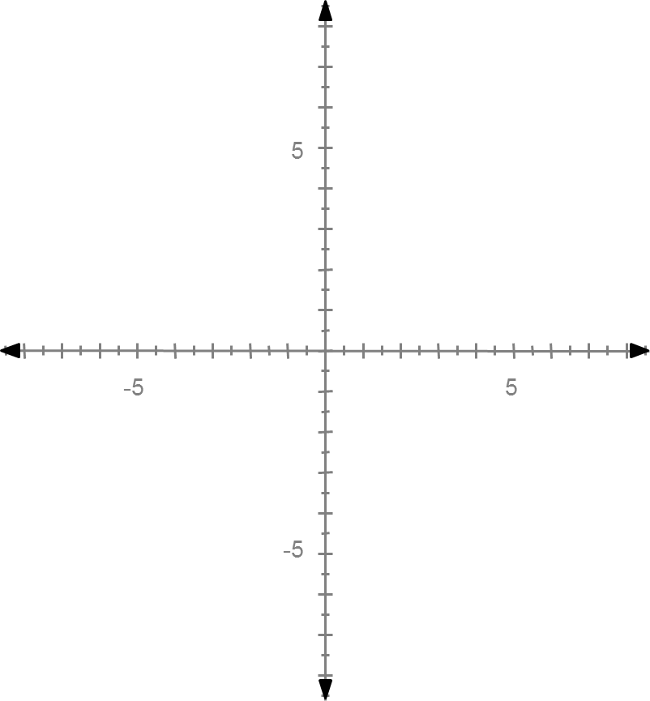
Vertical Line Test
Example:
Use the vertical
line test to
determine if
the graph
represents
a function.

Slide 13
Vertical Line Test
Example:
Does the graph
represent a
function?
Yes, because
it passes the
vertical line
test since the
vertical line
touches only 1
point at a time.

Slide 14
Vertical Line Test
Example 2:
Use the vertical
line test to
determine if
the graph
represents
a function.

Slide 15
Vertical Line Test
Example 2:
Does the graph
represent a
function?
No, because
it fails the
vertical line
test since the
vertical line
touches more
than 1 point at a time.

Slide 16
Functions Activity
Functions Sort.
You will be given a bag of cards. Sort the cards into 2 categories: Function OR Not a Function.

Slide 17
Graphs of Functions
The graph of a function can be continuous or discrete.

Slide 18
Continuous Functions
In the graph of a continuous function, the points are connected with a continuous line.
This is because every point on the line has meaning based on the original problem.

Slide 19
Continuous Function
Example:
A scientist measured the temperature of a liquid each hour from 10:00am to 2:00pm. At 10:00am, the temperature was 2⁰. She found that the temperature was rising by 2⁰ each hour.

Slide 20
Continuous Function
Example:
Create a table to represent this situation.

Slide 21
Continuous Function
Example:
Create a table to represent this situation.
Time | Temperature (in degrees)
10:00 am | 2
11:00 am | 4
12:00 pm | 6
1:00 pm | 8
2:00 pm | 10

Slide 22
Continuous Function
Example:
Create a graph to represent this situation.
Time | Temperature (in degrees)
10:00 am | 2
11:00 am | 4
12:00 pm | 6
1:00 pm | 8
2:00 pm | 10

Slide 23
Continuous Function
Example:
Create a graph to represent this situation.
Temperature
10
8
Time | Temperature (in degrees)
10:00 am | 2
11:00 am | 4
12:00 pm | 6
1:00 pm | 8
2:00 pm | 10
6
4
2
10:00 11:00 12:00 1:00 2:00
Time

Slide 24
Continuous Function
Example:
This graph is
continuous
because the
temperature was
rising steadily,
including between
measurements.
At 10:30, the temperature
might have been about 3⁰.
Temperature
10
8
6
4
2
10:00 11:00 12:00 1:00 2:00
Time

Slide 25
Continuous Function
Example:
Determine the
independent
and dependent
variables.
Independent: Time
(It is the one you
choose.)
Dependent: Temperature
(The temperature depends
on the time.)
Temperature
10
8
6
4
2
10:00 11:00 12:00 1:00 2:00
Time

Slide 26
Discrete Functions
In the graph of a discrete function, there are separate, distinct points.
These points are not connected by a line because only the points have meaning.
The points between the plotted points cannot be interpreted based on the original situation.

Slide 27
Discrete Function
Example:
Tickets for the movies cost $10 each. Determine the cost for 1, 2, 3, 4 or 5 people to go to the movies.

Slide 28
Discrete Function
Example:
Create a chart to represent this situation.

Slide 29
Discrete Function
Example:
Create a chart to represent this situation.
Number of Tickets Purchased | Total Cost
1 | $10
2 | $20
3 | $30
4 | $40
5 | $50

Slide 30
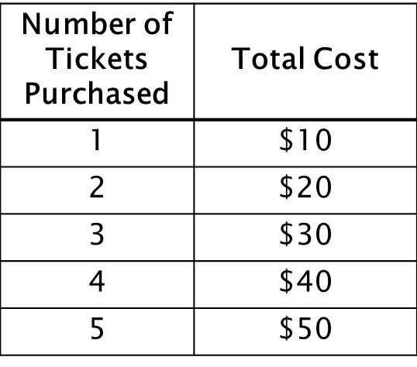
Discrete Function
Example:
Create a graph to represent this situation.

Slide 31
Discrete Function
Example:
Create a graph to represent this situation.
50
Total Cost
40
30
20
10
1 2 3 4 5
Number of tickets purchased

Slide 32
Discrete Function
Example:
This graph
represents a
discrete function.
You cannot buy
partial tickets.
(Example: 1.5, 2.4, etc.)
50
Total Cost
40
30
20
10
1 2 3 4 5
Number of tickets purchased

Slide 33
Discrete Function
Example:
Determine the
independent
and dependent
variables.
Independent:
Number of tickets
(It is the one you
choose.)
Dependent: Total Cost
(The total cost depends on
the number of tickets purchased.)
50
Total Cost
40
30
20
10
1 2 3 4 5
Number of tickets purchased

Slide 34
Homework
Functions Worksheet

