Slide 1
Linear Functions
SOL 8.14, SOL 8.16, SOL 8.17

Slide 2
Objectives
The student will be able to:
1) Construct a table of ordered pairs by substituting values for x in a linear equation to find values for y.
2) Plot in the coordinate plane ordered pairs (x, y) from a table.
3) Connect the ordered pairs to form a straight line (a continuous function).
4) Interpret the unit rate of the proportional relationship graphed as the slope of the graph, and compare two different proportional relationships represented in different ways.
5) Identify the domain and range of a relation.
Notes:
Mathematics Standards of Learning Curriculum Framework 2009: Grade 8, p. 29

Slide 3
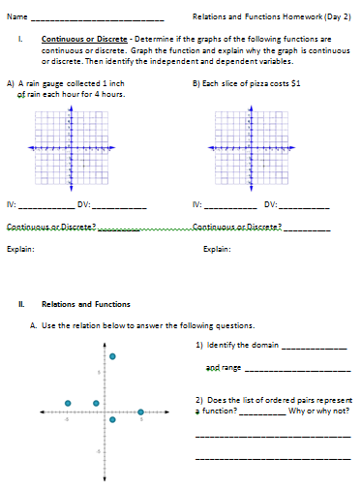
Homework

Slide 4
Homework
A) A rain gauge collected 1 inch of rain each hour for 4 hours.
1) Create a table of values
Time since measurement began (in hours) | Total rain in the gauge (in inches)
0 | 0
1 | 1
2 | 2
3 | 3
4 | 4

Slide 5
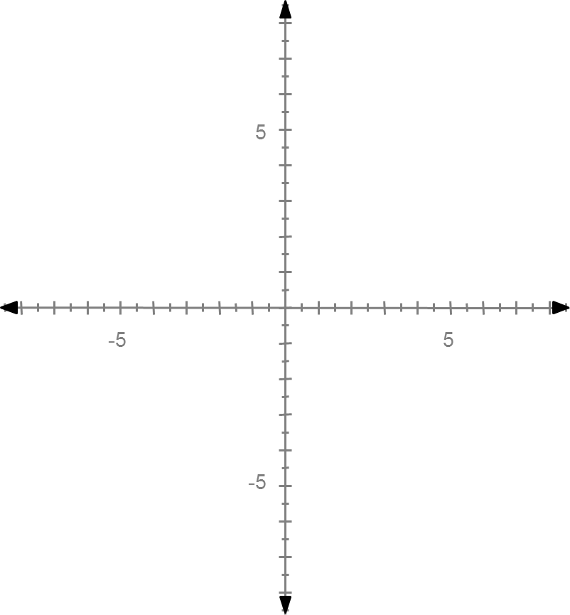
Homework
A) A rain gauge collected 1 inch of rain each hour for 4 hours.
2) Graph the data
Time since measurement began (in hours) | Total rain in the gauge (in inches)
0 | 0
1 | 1
2 | 2
3 | 3
4 | 4

Slide 6
Homework
A) A rain gauge collected 1 inch of rain each hour for 4 hours.
The graph is continuous
because the rain is
collecting in the gauge
between measurements.
Therefore, the points must
be connected by a line.
The line begins at (0,0) since
there cannot be negative amounts of rain.

Slide 7
Homework
A) A rain gauge collected 1 inch of rain each hour for 4 hours.
Independent variable:
Time
Dependent variable:
Amount of rain collected

Slide 8
Homework
B) Each slice of pizza costs $1
1) Create a table of values
Number of slices of pizza | Total cost
0 | 0
1 | 1
2 | 2
3 | 3
4 | 4

Slide 9
Homework
B) Each slice of pizza costs $1
2) Graph the data
Number of slices of pizza | Total cost
0 | 0
1 | 1
2 | 2
3 | 3
4 | 4

Slide 10
Homework
B) Each slice of pizza costs $1
The graph is discrete
because you would not
buy partial slices of pizza.
Therefore, the points
will not be connected
with a line.

Slide 11
Homework
B) Each slice of pizza costs $1
Independent variable:
Number of slices
of pizza
Dependent variable:
Total cost

Slide 12
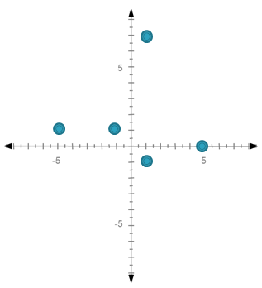
Relations and Functions
Use the relation below to answer the following questions.
Identify the domain {-5, -1, 1, 5}
and range {-1, 0, 1, 7}
2) Does the list of ordered pairs represent a function? No Why or why not?
It does not pass the vertical line test because it touches more than one point at a time.
The x-value “1” is paired with two y-values, “-1” and “7”

Slide 13
Review
What is a function?
Remember: A function is a rule that has a unique output value for each input value.
This means that there is only one y value for each x value.
What are domain and range?
Remember: The domain is the set of x coordinates.
Remember: The range is the set of y coordinates.

Slide 14
Linear Equations
A linear equation is a type of continuous function.
The graph of a linear equation is a straight line.
A linear equation represents a situation with a constant rate.
To graph a linear equation:
1) create a table
2) plot the ordered pairs
3) connect the points to form a straight line.

Slide 15
Graph each equation.
1) y = x – 3
Directions:
1) create a table
2) plot the ordered pairs
3) connect the points to form a straight line

Slide 16
1) y = x - 3
1) create a table
x |  | y

Slide 17
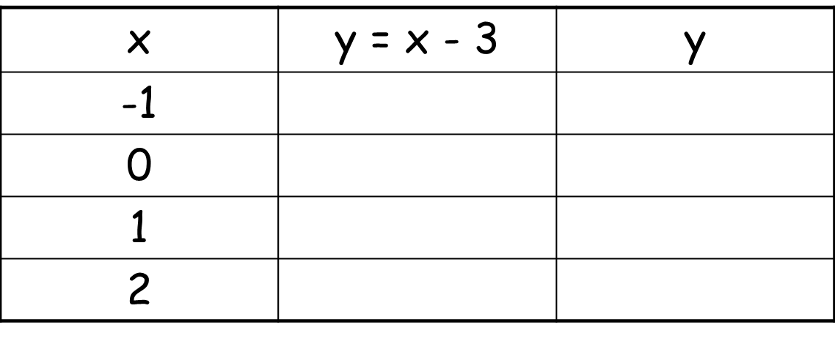
1) y = x - 3
1) create a table

Slide 18
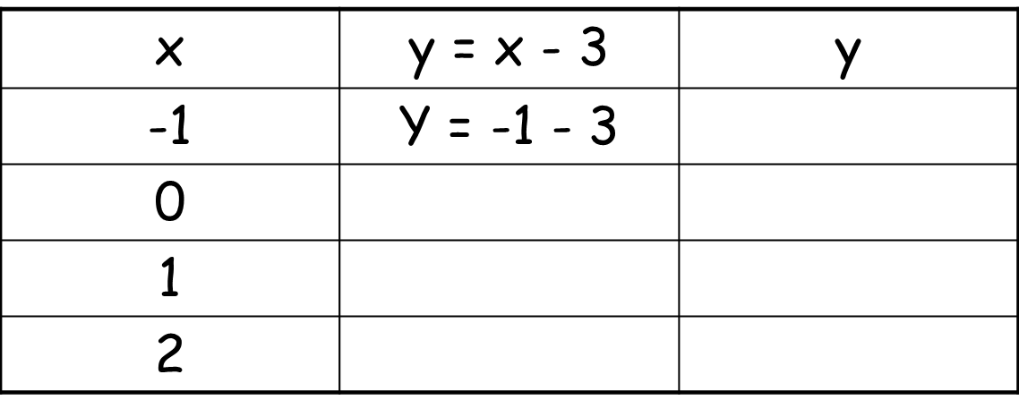
1) y = x - 3
1) create a table

Slide 19
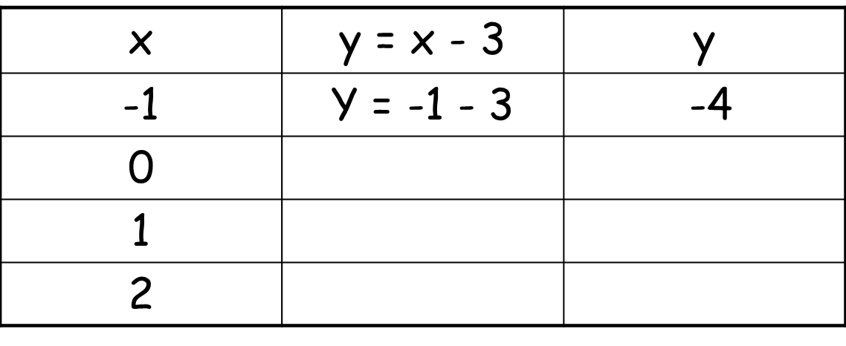
1) y = x - 3
1) create a table

Slide 20
1) y = x - 3
1) create a table

Slide 21
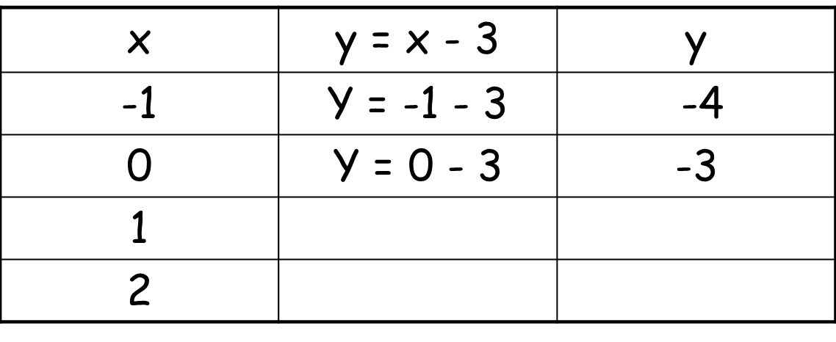
1) y = x - 3
1) create a table

Slide 22
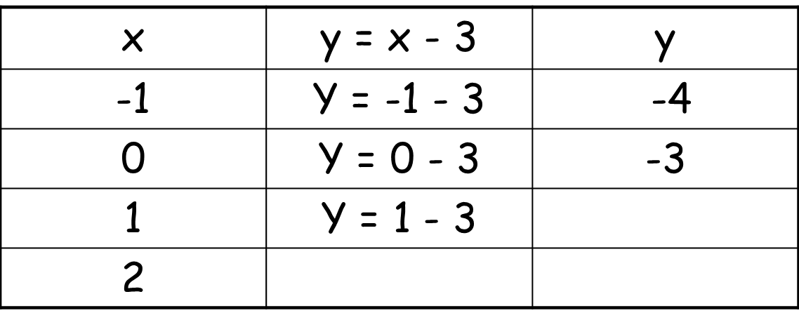
1) y = x - 3
1) create a table

Slide 23
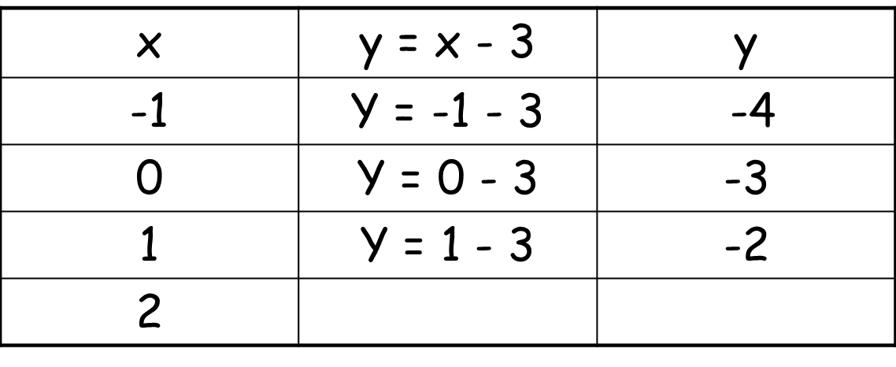
1) y = x - 3
1) create a table

Slide 24
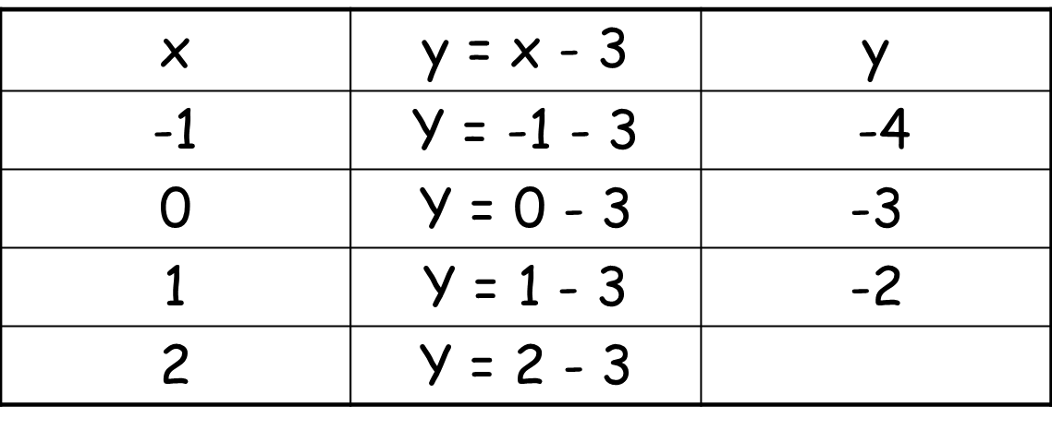
1) y = x - 3
1) create a table

Slide 25
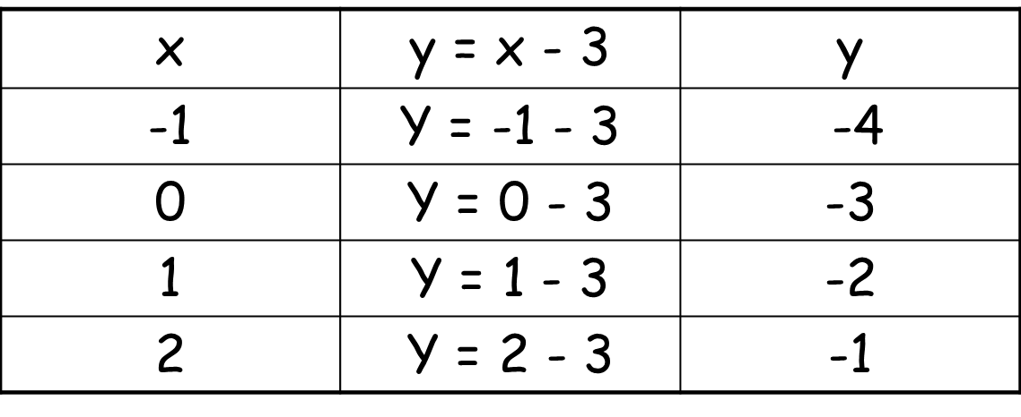
1) y = x - 3
1) create a table

Slide 26
1) y = x - 3
1) create a table

Slide 27
1) y = x - 3
2) Graph the ordered pairs.
3) Connect the points to form a straight line.
5
-5

5



-5

Slide 28
1) y = x - 3
Identify the domain and range of the ordered pairs.
Domain:
{-1, 0, 1, 2}
Range:
{-4, -3, -2, -1}

Slide 29
Graph each equation.
2) y = -3x
Directions:
1) create a table
2) plot the ordered pairs
3) connect the points to form a straight line

Slide 30
2) y = -3x
1) create a table

Slide 31
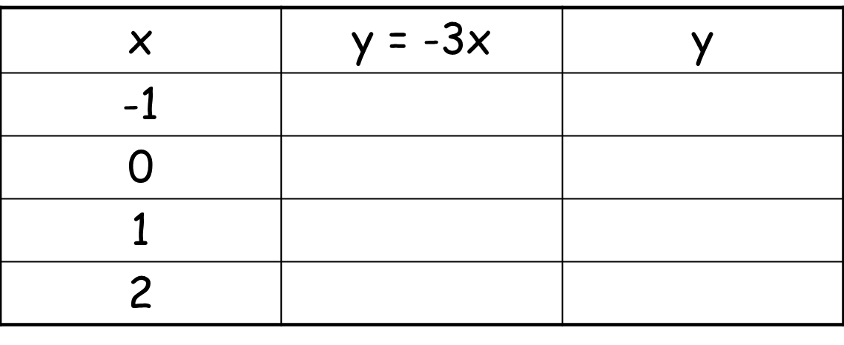
2) y = -3x
1) create a table

Slide 32
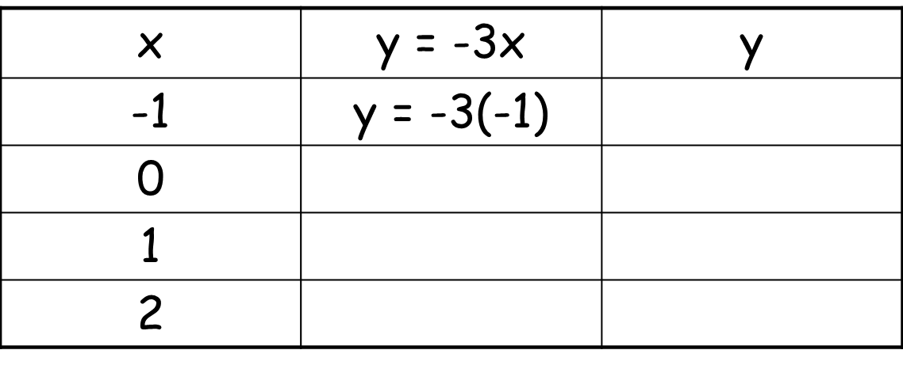
2) y = -3x
1) create a table

Slide 33
2) y = -3x
1) create a table

Slide 34
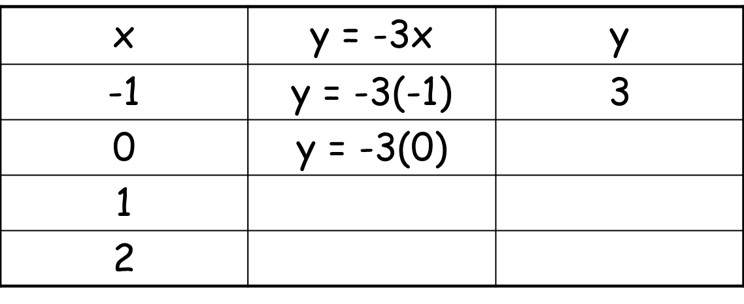
2) y = -3x
1) create a table

Slide 35
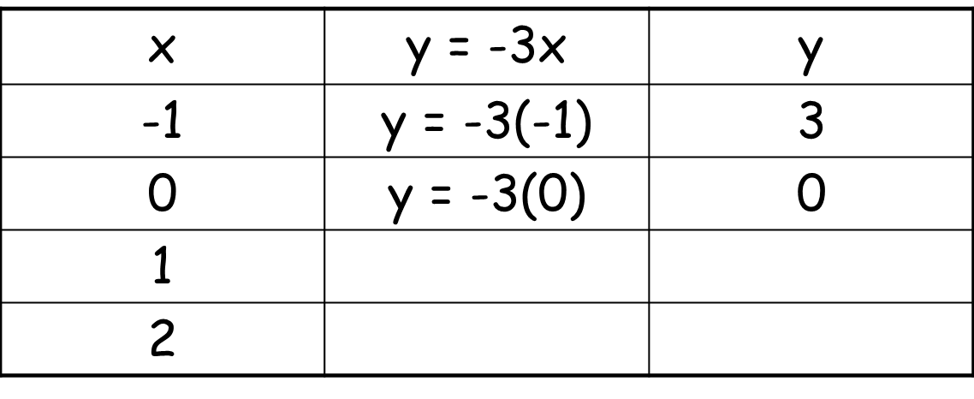
2) y = -3x
1) create a table

Slide 36
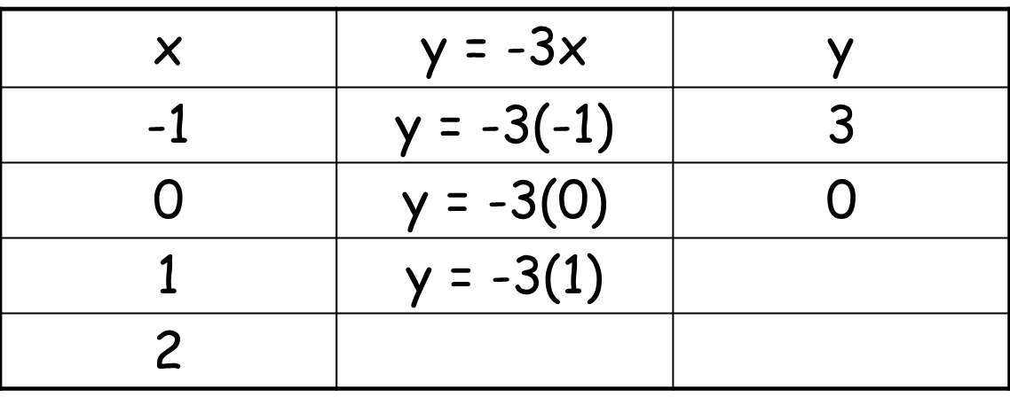
2) y = -3x
1) create a table

Slide 37
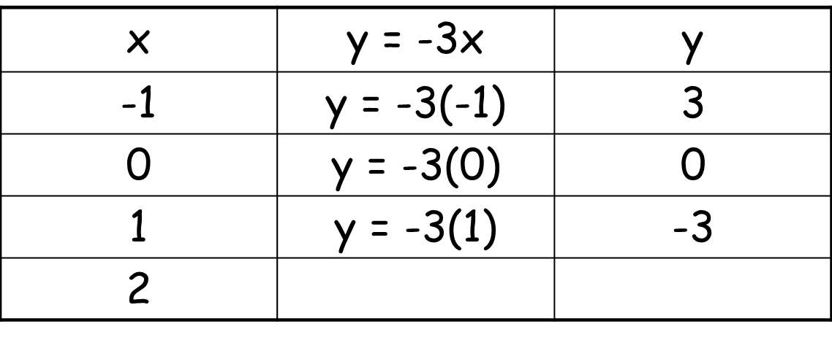
2) y = -3x
1) create a table

Slide 38
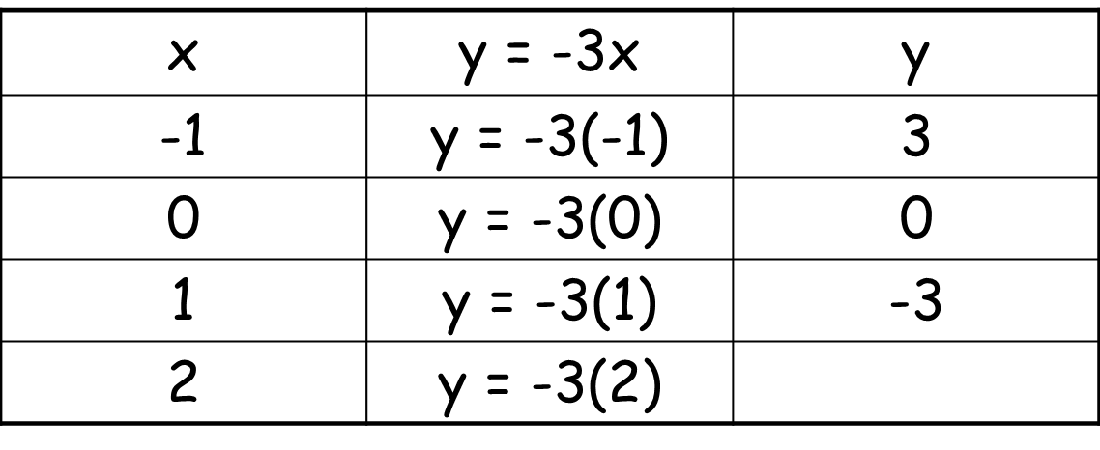
2) y = -3x
1) create a table

Slide 39
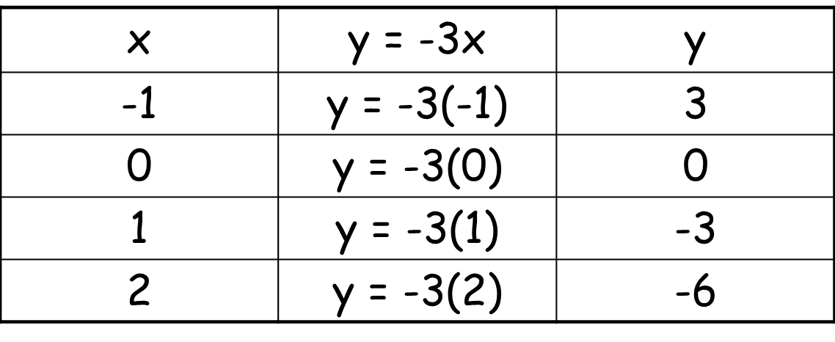
2) y = -3x
1) create a table

Slide 40
2) y = -3x
2) Graph the ordered pairs.
3) Connect the points to form
a straight line.
5


-5
5

-5

{(-1, 3), (0, 0), (1, -3), (2, -6)}

Slide 41
1) y = -3x
Identify the domain and range of the ordered pairs.
Domain:
{-1, 0, 1, 2}
Range:
{-6, -3, 0, 3}
{(-1, 3), (0, 0), (1, -3), (2, -6)}

Slide 42
Graph each equation.
3) y = -3x + 2
Directions:
1) create a table
2) plot the ordered pairs
3) connect the points to form a straight line

Slide 43
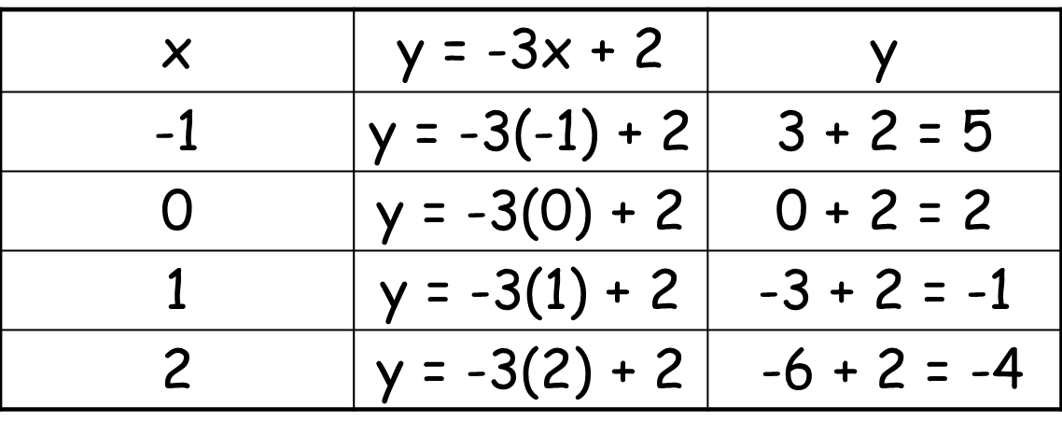
3) y = -3x + 2
1) create a table

Slide 44
3) y = -3x + 2
1) create a table

Slide 45
3) y = -3x + 2
1) create a table

Slide 46
3) y = -3x + 2
1) create a table

Slide 47
3) y = -3x + 2
1) create a table

Slide 48
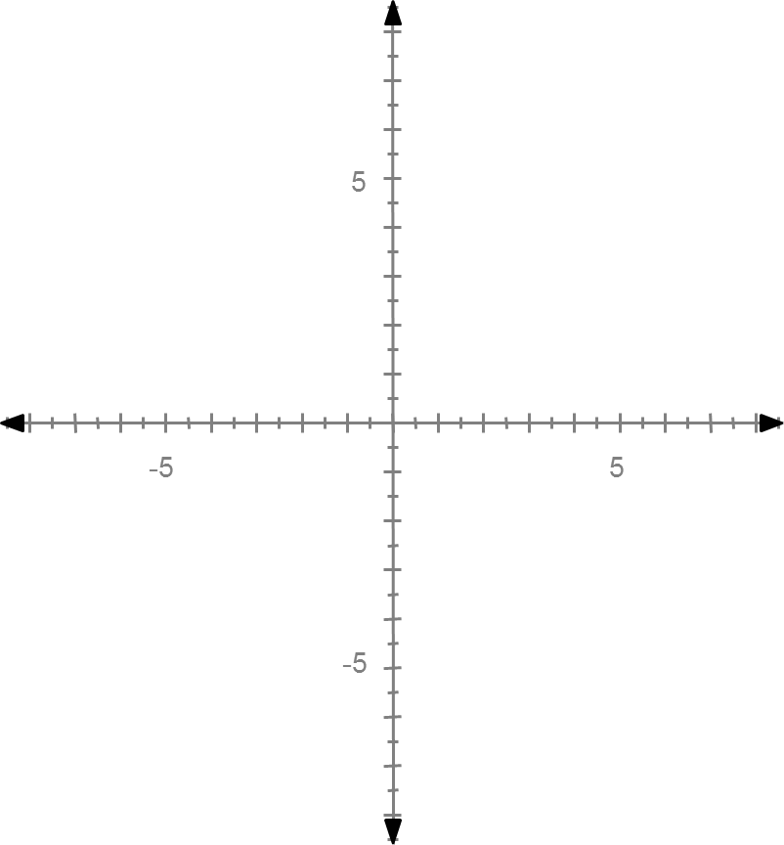
3) y = -3x + 2
2) Graph the ordered pairs.
3) Connect the points to form
a straight line.
{(-1, 5), (0, 2), (1, -1), (2, -4)}





Slide 49
1) y = -3x + 2
Identify the domain and range of the ordered pairs.
{(-1, 5), (0, 2), (1, -1), (2, -4)}
Domain:
{-1, 0, 1, 2}
Range:
{-4, -1, 2, 5}

Slide 50
II: Find four solutions of each equation, and write the solutions as ordered pairs.
x – y = 3
*Create a table. Choose “x” values and solve for “y” values.
x | x – y = 3 | y
-1 | -1 – y = 3 | -4
0 | 0 – y = 3 | -3
1 | 1 – y = 3 | -2
2 | 2 – y = 3 | -1

Slide 51
II: Find four solutions of each equation, and write the solutions as ordered pairs.
x – y = 3
*Create a table. Choose “x” values and solve for “y” values.
x | x – y = 3 | y
-1 | -1 – y = 3 | -4
0 | 0 – y = 3 | -3
1 | 1 – y = 3 | -2
2 | 2 – y = 3 | -1

Slide 52
II: Find four solutions of each equation, and write the solutions as ordered pairs.
x – y = 3
*Create a table. Choose “x” values and solve for “y” values.
x | x – y = 3 | y
-1 | -1 – y = 3 | -4
0 | 0 – y = 3 | -3
1 | 1 – y = 3 | -2
2 | 2 – y = 3 | -1

Slide 53
II: Find four solutions of each equation, and write the solutions as ordered pairs.
x – y = 3
*Create a table. Choose “x” values and solve for “y” values.
x | x – y = 3 | y
-1 | -1 – y = 3 | -4
0 | 0 – y = 3 | -3
1 | 1 – y = 3 | -2
2 | 2 – y = 3 | -1

Slide 54
II: Find four solutions of each equation, and write the solutions as ordered pairs.
x – y = 3
Ordered pairs:
{(-1, -4), (0, -3), (1, -2), (2, -1)}
x | x – y = 3 | y
-1 | -1 – y = 3 | -4
0 | 0 – y = 3 | -3
1 | 1 – y = 3 | -2
2 | 2 – y = 3 | -1

Slide 55
II: Find four solutions of each equation, and write the solutions as ordered pairs.
2) y = 5x - 6
*Create a table. Choose “x” values and solve for “y” values.
x | y = 5x - 6 | y
-1 | y = 5(-1) - 6 | -11
0 | y = 5(0) - 6 | -6
1 | y = 5(1) - 6 | -1
2 | y = 5(2) - 6 | 4

Slide 56
II: Find four solutions of each equation, and write the solutions as ordered pairs.
2) y = 5x - 6
*Create a table. Choose “x” values and solve for “y” values.
x | y = 5x - 6 | y
-1 | y = 5(-1) - 6 | -11
0 | y = 5(0) - 6 | -6
1 | y = 5(1) - 6 | -1
2 | y = 5(2) - 6 | 4

Slide 57
II: Find four solutions of each equation, and write the solutions as ordered pairs.
2) y = 5x - 6
*Create a table. Choose “x” values and solve for “y” values.
x | y = 5x - 6 | y
-1 | y = 5(-1) - 6 | -11
0 | y = 5(0) - 6 | -6
1 | y = 5(1) - 6 | -1
2 | y = 5(2) - 6 | 4

Slide 58
II: Find four solutions of each equation, and write the solutions as ordered pairs.
2) y = 5x - 6
*Create a table. Choose “x” values and solve for “y” values.
x | y = 5x - 6 | y
-1 | y = 5(-1) - 6 | -11
0 | y = 5(0) - 6 | -6
1 | y = 5(1) - 6 | -1
2 | y = 5(2) - 6 | 4

Slide 59
II: Find four solutions of each equation, and write the solutions as ordered pairs.
2) y = 5x – 6
Ordered pairs:
{(-1, -11), (0, -6), (1, -1), (2, 4)}
x | y = 5x - 6 | y
-1 | y = 5(-1) - 6 | -11
0 | y = 5(0) - 6 | -6
1 | y = 5(1) - 6 | -1
2 | y = 5(2) - 6 | 4

Slide 60
II: Find four solutions of each equation, and write the solutions as ordered pairs.
3)
*Create a table. Choose “x” values and solve for “y” values.
x | y = x/2 | y
-2 | y = -2/2 | -1
0 | y = 0/2 | 0
2 | y = 2/2 | 1
4 | y = 4/2 | 2

Slide 61
II: Find four solutions of each equation, and write the solutions as ordered pairs.
3)
*Create a table. Choose “x” values and solve for “y” values.
x | y = x/2 | y
-2 | y = -2/2 | -1
0 | y = 0/2 | 0
2 | y = 2/2 | 1
4 | y = 4/2 | 2

Slide 62
II: Find four solutions of each equation, and write the solutions as ordered pairs.
3)
*Create a table. Choose “x” values and solve for “y” values.
x | y = x/2 | y
-2 | y = -2/2 | -1
0 | y = 0/2 | 0
2 | y = 2/2 | 1
4 | y = 4/2 | 2

Slide 63
II: Find four solutions of each equation, and write the solutions as ordered pairs.
3)
*Create a table. Choose “x” values and solve for “y” values.
x | y = x/2 | y
-2 | y = -2/2 | -1
0 | y = 0/2 | 0
2 | y = 2/2 | 1
4 | y = 4/2 | 2

Slide 64
II: Find four solutions of each equation, and write the solutions as ordered pairs.
3)
Ordered Pairs:
{(-2, -1), (0, 0), (2, 1), (4, 2)}
x | y = x/2 | y
-2 | y = -2/2 | -1
0 | y = 0/2 | 0
2 | y = 2/2 | 1
4 | y = 4/2 | 2

Slide 65
Sort
Matching functions, graphs, and tables Flip Chart.

