Slide 1
Writing Function Rules
SOL 8.14

Slide 2
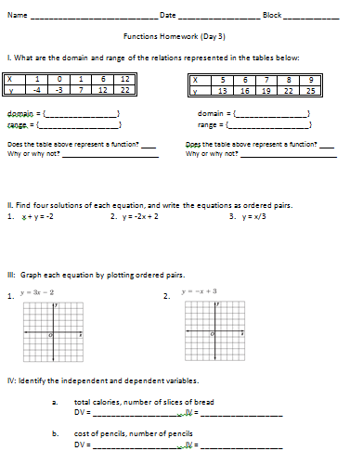
Homework:

Slide 3
Homework:
I. What are the domain and range of the relations represented in the tables below:
Domain: {0, 1, 6, 12}
Range: {-4, -3, 7, 12, 22}
x | 1 | 0 | 1 | 6 | 12
y | -4 | -3 | 7 | 12 | 22

Slide 4
Homework:
I. What are the domain and range of the relations represented in the tables below:
Does the table above represent a function?
No.
Why or why not?
Because 1 is paired with both -4 and 7.
x | 1 | 0 | 1 | 6 | 12
y | -4 | -3 | 7 | 12 | 22

Slide 5
Homework:
I. What are the domain and range of the relations represented in the tables below:
Domain: {5, 6, 7, 8, 9}
Range: {13, 16, 19, 22, 25}
x | 5 | 6 | 7 | 8 | 9
y | 13 | 16 | 19 | 22 | 25

Slide 6
Homework:
I. What are the domain and range of the relations represented in the tables below:
Does the table above represent a function?
Yes.
Why or why not?
Each x has only one y.
x | 5 | 6 | 7 | 8 | 9
y | 13 | 16 | 19 | 22 | 25

Slide 7
Homework
II. Find four solutions of each equation, and write the equations as ordered pairs.
1. x + y = -2
Answers include:
{(-1, -1), (0, -2), (1, -3), (2, -4)}

Slide 8
Homework
II. Find four solutions of each equation, and write the equations as ordered pairs.
2. y = -2x + 2
Answers include:
{(-1, 4), (0, 2), (1, 0), (2, -2)}

Slide 9
Homework
II. Find four solutions of each equation, and write the equations as ordered pairs.
3. y = x/3
Answers include:
{(-3, -1), (0, 0), (3, 1), (6, 2)}

Slide 10
Homework
III: Graph each equation by plotting ordered pairs.
1) y = 3x - 2
a) Make a table:
(pick x’s and solve
For y)
x | y
-1 | -5
0 | -2
1 | 1
2 | 4

Slide 11
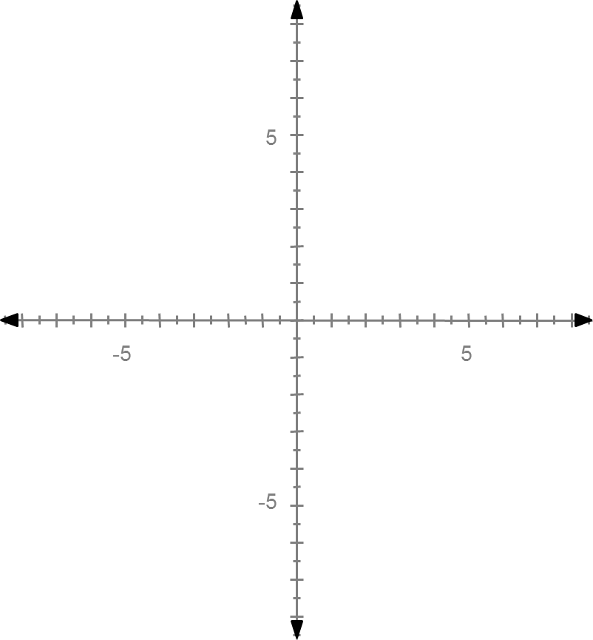
Homework
III: Graph each equation by plotting ordered pairs.
1) y = 3x - 2
b) Graph the
ordered
pairs.
x | y
-1 | -5
0 | -2
1 | 1
2 | 4

Slide 12
Homework
III: Graph each equation by plotting ordered pairs.
1) y = 3x - 2
c) Connect
the points
with a straight
line.

Slide 13
Homework
III: Graph each equation by plotting ordered pairs.
2) y = -x + 3
a) Make a table:
(pick x’s and solve
For y)
x | y
-1 | 4
0 | 3
1 | 2
2 | 1

Slide 14
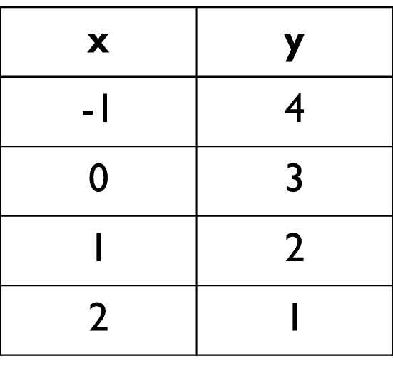
Homework
III: Graph each equation by plotting ordered pairs.
2) y = -x +3
b) Graph the
ordered
pairs.

Slide 15
Homework
III: Graph each equation by plotting ordered pairs.
2) y = -x +3
b) Connect
the points
with a straight
line.

Slide 16
Homework
IV: Identify the independent and dependent variables.
total calories, number of slices of bread
DV = Total Calories IV = Number of slices of bread
cost of pencils, number of pencils
DV = Cost of pencils IV = Number of pencils

Slide 17
Objectives:
Determine if a relationship represents a function.
Given a function, write the relationship in words, as an equation, and/or complete a table of values.

Slide 18
Functions can be represented as tables, graphs, equations, physical models, or in words.
Mathematics Standards of Learning Curriculum Framework 2009: Grade 8, p. 25

Slide 19
Example 1:
Tim’s salary as a lifeguard depends on the number of hours he works. If he is paid $9.00 an hour, what is his salary for 3 hours? 12 hours? 22 hours?
Is his salary a function of the hours he works? Explain.
Yes. For each number of hours he works, he will have only one salary.

Slide 20
Example 1:
Tim’s salary as a lifeguard depends on the number of hours he works. If he is paid $9.00 an hour, what is his salary for 3 hours? 12 hours? 22 hours?
If possible, write the rule. Then, create a table of values.
* Words:
His salary is equal to $9.00 times the number of hours he works.
* Equation:
s = 9h or y = 9x

Slide 21
Example 1:
Tim’s salary as a lifeguard depends on the number of hours he works. If he is paid $9.00 an hour, what is his salary for 3 hours? 12 hours? 22 hours?
Input | Rule | Output

Slide 22
Example 1:
Tim’s salary as a lifeguard depends on the number of hours he works. If he is paid $9.00 an hour, what is his salary for 3 hours? 12 hours? 22 hours?
Input (Hours- h) | Rule S = 9h | Output (Salary - S)

Slide 23
Example 1:
Tim’s salary as a lifeguard depends on the number of hours he works. If he is paid $9.00 an hour, what is his salary for 3 hours? 12 hours? 22 hours?
Input (Hours- h) | Rule S = 9h | Output (Salary - S)
3 | s = 9(3) | $27.00

Slide 24
Example 1:
Tim’s salary as a lifeguard depends on the number of hours he works. If he is paid $9.00 an hour, what is his salary for 3 hours? 12 hours? 22 hours?
Input (Hours- h) | Rule S = 9h | Output (Salary - S)
3 | s = 9(3) | $27.00
12 | s= 9(12) | $108

Slide 25
Example 1:
Tim’s salary as a lifeguard depends on the number of hours he works. If he is paid $9.00 an hour, what is his salary for 3 hours? 12 hours? 22 hours?
Input (Hours- h) | Rule S = 9h | Output (Salary - S)
3 | s = 9(3) | $27.00
12 | s= 9(12) | $108
22 | s = 9(22) | $198

Slide 26
Example 2
The distance that Missy rides her bike depends on the number of minutes that she spends riding her bike. If she rides her bike at a constant rate of 0.15 miles per minute, what distance does Missy ride her bike in 15 minutes? 30 minutes? 1 hour?

Slide 27
Example 2
Is the distance she rides her bike a function of the number of minutes she bikes? Explain.
Yes. For each amount of time she rides her bike, she travels a different distance.
If possible, write the rule. Then create a table of values.
Words:
The distance she rides her bike is equal to 0.15 times the number of minutes.
Equation:
d = 0.15m or y = 0.15x

Slide 28
Example 2
The distance that Missy rides her bike depends on the number of minutes that she spends riding her bike. If she rides her bike at a constant rate of 0.15 miles per minute, what distance does Missy ride her bike in 15 minutes? 30 minutes? 1 hour?
Input | Rule | Output

Slide 29
Example 2
The distance that Missy rides her bike depends on the number of minutes that she spends riding her bike. If she rides her bike at a constant rate of 0.15 miles per minute, what distance does Missy ride her bike in 15 minutes? 30 minutes? 1 hour?
Input (Number of minutes – m) | Rule d = 0.15m | Output (Distance in miles – d)

Slide 30
Example 2
The distance that Missy rides her bike depends on the number of minutes that she spends riding her bike. If she rides her bike at a constant rate of 0.15 miles per minute, what distance does Missy ride her bike in 15 minutes? 30 minutes? 1 hour?
Input (Number of minutes – m) | Rule d = 0.15m | Output (Distance in miles – d)
15 | d = 0.15(15) | 2.25

Slide 31
Example 2
The distance that Missy rides her bike depends on the number of minutes that she spends riding her bike. If she rides her bike at a constant rate of 0.15 miles per minute, what distance does Missy ride her bike in 15 minutes? 30 minutes? 1 hour?
Input (Number of minutes – m) | Rule d = 0.15m | Output (Distance in miles – d)
15 | d = 0.15(15) | 2.25
30 | d = 0.15(30) | 4.5

Slide 32
Example 2
The distance that Missy rides her bike depends on the number of minutes that she spends riding her bike. If she rides her bike at a constant rate of 0.15 miles per minute, what distance does Missy ride her bike in 15 minutes? 30 minutes? 1 hour?
Input (Number of minutes – m) | Rule d = 0.15m | Output (Distance in miles – d)
15 | d = 0.15(15) | 2.25
30 | d = 0.15(30) | 4.5
60 | d = 0.15(60) | 9

Slide 33
Example 3
Is the cost a function of the number of items? Explain.
No. Four (4) items can cost either $6 or $15.
Input (items) | 4 | 9 | 1 | 8 | 4
Output (cost) | $6 | $12 | $2.50 | $3 | $15

Slide 34
Example 3
If possible, write the rule.
Since the change is not constant, a rule cannot be written.
Words:
Equation:

Slide 35
Example 4
Is the price a function of the number of donuts? Explain.
Yes. Each number of donuts (input) has a different cost (output.) Each donut costs $1.25.
Input (number of donuts) | 1 | 2 | 3 | 4 | 5
Output (cost of the donuts) | $1.25 | $2.50 | $3.75 | $5.00 | $6.25

Slide 36
Example 4
If possible, write the rule.
Words:
The total cost is equal to the number of donuts times $1.25
Equation:
c = 1.25n or y = 1.25x
Input (number of donuts) | 1 | 2 | 3 | 4 | 5
Output (cost of the donuts) | $1.25 | $2.50 | $3.75 | $5.00 | $6.25

Slide 37
Example 5
Some plants need a large amount of space in order to grow. The number of seeds that can be planted in each row is related to the length of the row. Examine the table below. Does the relationship represent a function? Explain.

Slide 38
Example 5
Examine the table below. Does the relationship represent a function? Explain.
Yes. Each row has a different number or seeds in it.
Input (row length) | Output (# of seeds per row)
16 | 4
24 | 6
52 | 13
64 | 16

Slide 39
Example 5
If possible, write the rule.
Words:
The number of seeds in each row is equal to the row length divided by 4.
Equation:
d = r/4 or y = x/4
Input (row length) | Output (# of seeds per row)
16 | 4
24 | 6
52 | 13
64 | 16

Slide 40
Example 6
Is the relationship a function? Explain. If possible, write the function rule.
a)
*Yes, it is a function. Each input (x) has only one output (y).
* y = x²
Input | 2 | 5 | 0 | 6 | 4
Output | 4 | 25 | 0 | 36 | 16

Slide 41
Example 6
Is the relationship a function? Explain. If possible, write the function rule.
b)
*It is not a function. 1 is paired with both 10 and 50. 2 is paired with both 20 and 40.
Input | 1 | 2 | 3 | 2 | 1
Output | 10 | 20 | 30 | 40 | 50

