Slide 1
Writing Linear Equations (2)
SOL 8.14, 8.16, and 8.17

Slide 2
Objectives
The student will be able to write an equation given a table of values.

Slide 3
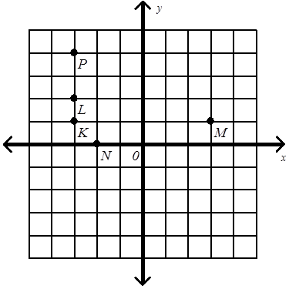
Homework
Part I: The Coordinate Plane. Identify and label the points on the coordinate plane below:
1) Plot A (3, -3)
Location: Quadrant IV
2) Plot B (0, -2)
Location: y-axis
3) Plot C (5, 0)
Location: x-axis
Identify point K: (-3, 1)
5) Identify point L: (-3, 2)
6) Identify point M: (3, 1)
C
B
A

Slide 4
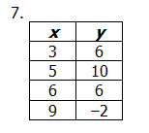
Homework
Part II: To Be or Not to Be … A Function
Do the following relationships represent functions? Explain your answer.
It represents a function
because each x has only
one y.

Slide 5
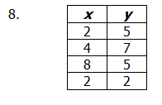
Homework
Part II: To Be or Not to Be … A Function
Do the following relationships represent functions? Explain your answer.
It does not represent a
function because the x-
value “2” is paired with
both 2 and 5.

Slide 6
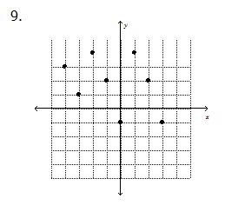
Homework
Part II: To Be or Not to Be … A Function
Do the following relationships represent functions? Explain your answer.
It represents a function
because it passes the
vertical line test since a
vertical line touches only 1
point at a time.

Slide 7
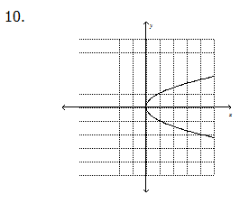
Homework
Part II: To Be or Not to Be … A Function
Do the following relationships represent functions? Explain your answer.
It does not represent a
function because it does
not pass the vertical line
test since a vertical line
touches more than one point at a time.

Slide 8
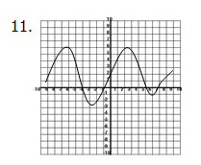
Homework
Part II: To Be or Not to Be … A Function
Do the following relationships represent functions? Explain your answer.
It represents a function
because it passes the
vertical line test since a
vertical line touches only 1
point at a time.

Slide 9
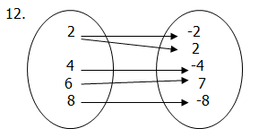
Homework
Part II: To Be or Not to Be … A Function
Do the following relationships represent functions? Explain your answer.
It does not represent a
function because the x-
value “2” is paired with
both -2 and 2.

Slide 10
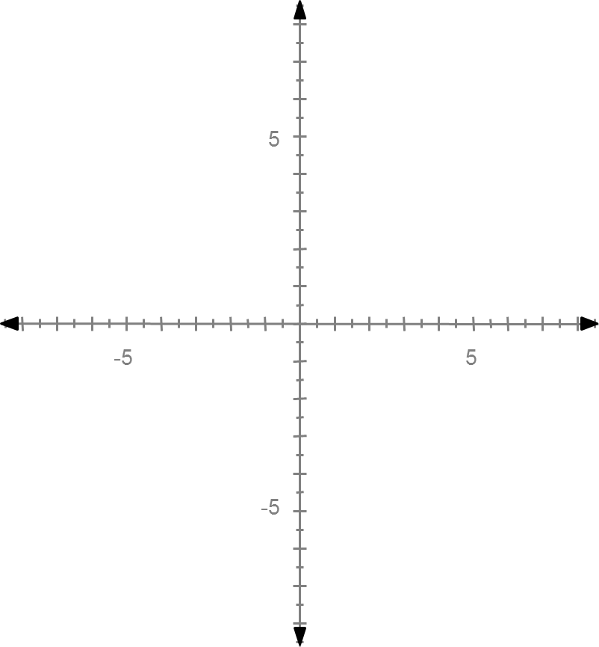
Homework
# 13 – 14 Given the following linear function, complete the table of values and graph on the coordinate plane provided. Then, identify the domain and range
of the table of values.
13) y = 2x + 1
x | y
-2 | -3
-1 | -1
0 | 1
2 | 5
3 | 7

Slide 11
Homework
# 13 – 14 Given the following linear function, complete the table of values and graph on the coordinate plane provided. Then, identify the domain and range
of the table of values.
13) y = 2x + 1 Domain: {-2, -1, 0, 2, 3}
Range: {-3, -1, 1, 5, 7}
x | y
-2 | -3
-1 | -1
0 | 1
2 | 5
3 | 7

Slide 12
Homework
# 13 – 14 Given the following linear function, complete the table of values and graph on the coordinate plane provided. Then, identify the domain and range
of the table of values.
14) y = x – 2
3
x | y
-6 | -4
-3 | -3
0 | -2
3 | -1
6 | 0

Slide 13
Homework
# 13 – 14 Given the following linear function, complete the table of values and graph on the coordinate plane provided. Then, identify the domain and range
of the table of values.
14) y = x – 2 Domain: {-6, -3, 0, 3, 6}
3
Range: {-4, -3, -2, -1, 0}
x | y
-6 | -4
-3 | -3
0 | -2
3 | -1
6 | 0

Slide 14
Homework
15. Identify the range of the function y = x² + 1 for the domain {-4, 5, 8}.
y = (-4)² + 1
= 17
Range: {17, 26, 65}
y = (5)² + 1
= 26
y = (8)² + 1
= 65

Slide 15
Homework
# 16 – 17 Complete the table for each equation.
16) y = -6x + 1
x | y
1 | -5
2 | -11
-2 | 13

Slide 16
Homework
# 16 – 17 Complete the table for each equation.
16) y = x
4
x | y
8 | 2
16 | 4
-24 | -6

Slide 17
Questions?

Slide 18
Quiz

Slide 19
Writing Linear Equations (Function Rules)
1-Step
Equations:
Determine what happens from x to y. If it is increasing, you will need to add or multiply. If it is decreasing, you will need to subtract or divide.

Slide 20
Practice
1)
x | y
-1 | -4
0 | 0
1 | 4
2 | 8
3 | 12
Helpful Hint: Look at the “0” term in the x column. If the y is also “0,” try multiplication or division. If the y is a number other than “0,” that is the amount that is added or subtracted.

Slide 21
Practice
1)
x | y
-1 | -4
0 | 0
1 | 4
2 | 8
3 | 12
Helpful Hint: Look at the “0” term in the x column. If the y is also “0,” try multiplication or division. If the y is a number other than “0,” that is the amount that is added or subtracted.

Slide 22
Practice
1) Since y = 0, when x = 0,
look for a number to multiply
or divide each number in
the x column by to get the
answer in the y column.
x | y
-1 | -4
0 | 0
1 | 4
2 | 8
3 | 12
Helpful Hint: Look at the “0” term in the x column. If the y is also “0,” try multiplication or division. If the y is a number other than “0,” that is the amount that is added or subtracted.

Slide 23
Practice
1)
(-1) * 4 = -4
0 * 4 = 0
1 * 4 = 4
2 * 4 = 8
3 * 4 = 12
x | y
-1 | -4
0 | 0
1 | 4
2 | 8
3 | 12
Helpful Hint: Look at the “0” term in the x column. If the y is also “0,” try multiplication or division. If the y is a number other than “0,” that is the amount that is added or subtracted.

Slide 24
Practice
1)
Each y value can be found
multiplying each x value
by 4. Therefore, the
equation is: y = 4x
x | y
-1 | -4
0 | 0
1 | 4
2 | 8
3 | 12
Helpful Hint: Look at the “0” term in the x column. If the y is also “0,” try multiplication or division. If the y is a number other than “0,” that is the amount that is added or subtracted.

Slide 25
Practice
2)
x | y
-1 | -4
0 | -3
1 | -2
2 | -1
3 | 0
Helpful Hint: Look at the “0” term in the x column. If the y is also “0,” try multiplication or division. If the y is a number other than “0,” that is the amount that is added or subtracted.

Slide 26
Practice
2)
x | y
-1 | -4
0 | -3
1 | -2
2 | -1
3 | 0
Helpful Hint: Look at the “0” term in the x column. If the y is also “0,” try multiplication or division. If the y is a number other than “0,” that is the amount that is added or subtracted.

Slide 27
Practice
2)
Since y = -3 when
x = 0, check to see if
each y value can be
found by subtracting
3 from x.
x | y
-1 | -4
0 | -3
1 | -2
2 | -1
3 | 0
Helpful Hint: Look at the “0” term in the x column. If the y is also “0,” try multiplication or division. If the y is a number other than “0,” that is the amount that is added or subtracted.

Slide 28
Practice
2)
-1 – 3 = -4
0 – 3 = -3
1 – 3 = -2
2 – 3 = -1
3 – 3 = 0
x | y
-1 | -4
0 | -3
1 | -2
2 | -1
3 | 0
Helpful Hint: Look at the “0” term in the x column. If the y is also “0,” try multiplication or division. If the y is a number other than “0,” that is the amount that is added or subtracted.

Slide 29
Practice
2)
Each of the y values can
be found by subtracting
3 from the x value.
Therefore, the equation
is y = x - 3
x | y
-1 | -4
0 | -3
1 | -2
2 | -1
3 | 0
Helpful Hint: Look at the “0” term in the x column. If the y is also “0,” try multiplication or division. If the y is a number other than “0,” that is the amount that is added or subtracted.

Slide 30
Practice
3)
x | y
-6 | 2
-3 | 1
0 | 0
3 | -1
12 | -4
Helpful Hint: Look at the “0” term in the x column. If the y is also “0,” try multiplication or division. If the y is a number other than “0,” that is the amount that is added or subtracted.

Slide 31
Practice
3)
x | y
-6 | 2
-3 | 1
0 | 0
3 | -1
12 | -4
Helpful Hint: Look at the “0” term in the x column. If the y is also “0,” try multiplication or division. If the y is a number other than “0,” that is the amount that is added or subtracted.

Slide 32
Practice
3) Since y = 0, when x = 0,
look for a number to multiply
or divide each number in
the x column by to get the
answer in the y column.
x | y
-6 | 2
-3 | 1
0 | 0
3 | -1
12 | -4
Helpful Hint: Look at the “0” term in the x column. If the y is also “0,” try multiplication or division. If the y is a number other than “0,” that is the amount that is added or subtracted.

Slide 33
Practice
3)
-6/-3 = 2
-3/-3 = 1
0/-3 = 0
3/-3 = -1
12/-3 = -4
x | y
-6 | 2
-3 | 1
0 | 0
3 | -1
12 | -4
Helpful Hint: Look at the “0” term in the x column. If the y is also “0,” try multiplication or division. If the y is a number other than “0,” that is the amount that is added or subtracted.

Slide 34
Practice
3)
Since each y value can be found by dividing the x value
by -3, the equation is
y = x/-3.
x | y
-6 | 2
-3 | 1
0 | 0
3 | -1
12 | -4
Helpful Hint: Look at the “0” term in the x column. If the y is also “0,” try multiplication or division. If the y is a number other than “0,” that is the amount that is added or subtracted.

Slide 35
2-Step Equations
Step 1: What is “y” when “x” equals 0? This is the constant that is added or subtracted.
Step 2: Add or subtract that number and then look for the change from x to y. (Use the opposite operation!)
Step 3: Use this to help you find what to multiply or divide. Try numbers in the equation until you find the rule. Think about your results as you try numbers and then make adjustments.
Step 4: Check your rule with each of the ordered pairs.
* Note: If there is no value for x = 0, extend the patterns to find what y equals when x = 0.

Slide 36
Practice
Use the 4 steps to write the rule for the following:
A) Step 1: What is y when x = 0?
When x = 0, y = -2.
Can each y value be found by subtracting
2 from each x value?
No. (-1) – 2 does not equal -4. This is a
2-step equation.
x | y
-1 | -4
0 | -2
1 | 0
2 | 2
3 | 4

Slide 37
Practice
Use the 4 steps to write the rule for the following:
A) Step 1: What is y when x = 0?
Therefore, part of the equation is
y = ___x - 2
x | y
-1 | -4
0 | -2
1 | 0
2 | 2
3 | 4

Slide 38
Practice
Use the 4 steps to write the rule for the following:
A) Step 2: Add or subtract that number and then look for the change from x to y. (Use the opposite operation!)
Since it is -2, the opposite operation is
addition. Add 2 to each value in the
y column.
x | y
-1 | -4
0 | -2
1 | 0
2 | 2
3 | 4

Slide 39
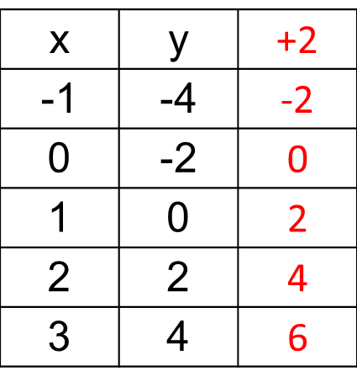
Practice
Use the 4 steps to write the rule for the following:
A) Step 2: Add or subtract that number and then look for the change from x to y. (Use the opposite operation!)
Since it is -2, the opposite operation is
addition. Add 2 to each value in the
y column.

Slide 40
Practice
Use the 4 steps to write the rule for the following:
A) Step 3: Use this to help you find what to multiply or divide. Try numbers in the equation until you find the rule. Think about your results as you try numbers and then make adjustments.
-1 * 2 = -2
0 * 2 = 0
1 * 2 = 2
2 * 2 = 4
3 * 2 = 6
x | y | +2
-1 | -4 | -2
0 | -2 | 0
1 | 0 | 2
2 | 2 | 4
3 | 4 | 6

Slide 41
Practice
Use the 4 steps to write the rule for the following:
A) Step 3: Use this to help you find what to multiply or divide. Try numbers in the equation until you find the rule. Think about your results as you try numbers and then make adjustments.
Since each new value can be found by
multiplying the x values by 2, this is the
other part of the 2-step equation.
x | y | +2
-1 | -4 | -2
0 | -2 | 0
1 | 0 | 2
2 | 2 | 4
3 | 4 | 6

Slide 42
Practice
Use the 4 steps to write the rule for the following:
A) Step 3: Use this to help you find what to multiply or divide. Try numbers in the equation until you find the rule. Think about your results as you try numbers and then make adjustments.
The 2-step equation is: y = 2x – 2.
x | y
-1 | -4
0 | -2
1 | 0
2 | 2
3 | 4

Slide 43
Practice
Use the 4 steps to write the rule for the following:
A) Step 4: Check your rule with each of the ordered pairs.
y = 2x – 2.
y = 2(-1) – 2 y = 2(2) - 2
= -4 = 2
y = 2(0) – 2 y = 2(3) - 2
= -2 = 4
y = 2(1) – 2
= 0
x | y
-1 | -4
0 | -2
1 | 0
2 | 2
3 | 4

Slide 44
Practice
Use the 4 steps to write the rule for the following:
B) Step 1: What is y when x = 0?
It is not included in the table.
Extend the pattern to find what y equals when x = 0.
X = 0 would be between -2 and 2 and fit with the pattern of increase/decrease by 2. Therefore, when x = 0, y = 1.
x | y
-4 | -1
-2 | 0
2 | 2
4 | 3
6 | 4

Slide 45
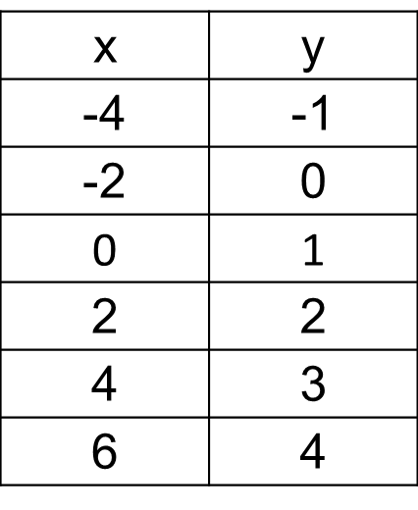
Practice
Use the 4 steps to write the rule for the following:
B) Step 1: What is y when x = 0?
When x = 0, y = 1.
Can each y value be found by adding
1 to each x value?
No. (-2) + 1 does not equal 0. This is a
2-step equation.

Slide 46
Practice
Use the 4 steps to write the rule for the following:
B) Step 1: What is y when x = 0?
Therefore, part of the equation is
y = ___x + 1

Slide 47
Practice
Use the 4 steps to write the rule for the following:
B) Step 2: Add or subtract that number and then look for the change from x to y. (Use the opposite operation!)
Since it is 1, the opposite operation is
subtraction. Subtract 1 from each value in the y column.

Slide 48
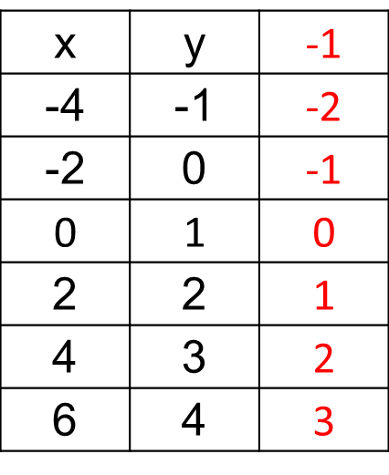
Practice
Use the 4 steps to write the rule for the following:
B) Step 2: Add or subtract that number and then look for the change from x to y. (Use the opposite operation!)
Since it is 1, the opposite operation is
subtraction. Subtract 1 from each value in the y column.

Slide 49
Practice
Use the 4 steps to write the rule for the following:
B) Step 3: Use this to help you find what to multiply or divide. Try numbers in the equation until you find the rule. Think about your results as you try numbers and then make adjustments.
-4/2 = -2
-2/2 = -1
0/2 = 0
2/2 = 1
4/2 = 2
6/2 = 3

Slide 50
Practice
Use the 4 steps to write the rule for the following:
B) Step 3: Use this to help you find what to multiply or divide. Try numbers in the equation until you find the rule. Think about your results as you try numbers and then make adjustments.
Since each new value can be found by
dividing the x values by 2, this is the
other part of the 2-step equation.

Slide 51
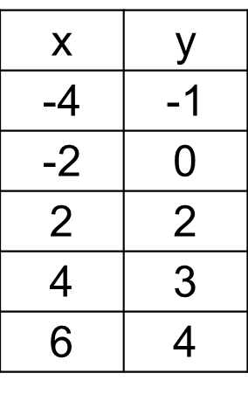
Practice
Use the 4 steps to write the rule for the following:
B) Step 3: Use this to help you find what to multiply or divide. Try numbers in the equation until you find the rule. Think about your results as you try numbers and then make adjustments.
The 2-step equation is:

Slide 52
Practice
Use the 4 steps to write the rule for the following:
B) Step 4: Check your rule with each of the ordered pairs.
y = -4/2 + 1 y = 4/2 + 1
= -1 = 3
y = -2/2 + 1 y = 6/2 + 1
= 0 = 4
y = 2/2 + 1
= 2

Slide 53
Practice
Use the 4 steps to write the rule for the following:
C) The 2-step equation is:
y = 3x + 2
x | y
-1 | -1
0 | 2
1 | 5
2 | 8
3 | 11

Slide 54
Practice
Use the 4 steps to write the rule for the following:
D) The 2-step equation is:
y = -x + 3
x | y
-1 | 4
0 | 3
1 | 2
2 | 1
3 | 0

Slide 55
Practice
Use the 4 steps to write the rule for the following:
E) The 2-step equation is:
x | y
-4 | 0
4 | 2
8 | 3
12 | 4
20 | 6

Slide 56
Practice
Use the 4 steps to write the rule for the following:
F) The 2-step equation is:
y = 5x + 3
x | y
-1 | -2
0 | 3
2 | 13
4 | 23
7 | 38

