Slide 1
RELATIONS AND FUNCTIONS
SOL 8.14, 8.16, 8.17

Slide 2
Vocabulary
Relation: A relation is a set of ordered pairs.

Slide 3
Relation
This chart is a relation
because it is a set of
ordered pairs.
Relations can be represented in multiple ways, including as ordered pairs, a table, a mapping, or as a graph.
x | y
2 | 5
3 | 0
-2 | 8

Slide 4
Vocabulary
Function: a relation in which each element of the input (domain) is paired with exactly one element in the output (range) according to a specified rule.
Each x has only 1 y.

Slide 5
Function
Example:
{(1, 2), (2, 2), (-4, 3), (0, 3)}
is a function because each x value is paired with only 1 y value.

Slide 6
Functions
A function can be represented in several ways, including:
a. Ordered Pairs:
{(1,2), (-3,1), (0,4), (2, -5)}

Slide 7
Functions
b. Words:
Movie tickets cost $11.00 each.
For each movie ticket bought, it will cost $11.00.

Slide 8
Relations
c. Table:
X | Y
1 | 2
-2 | 4
3 | 0
4 | 5

Slide 9
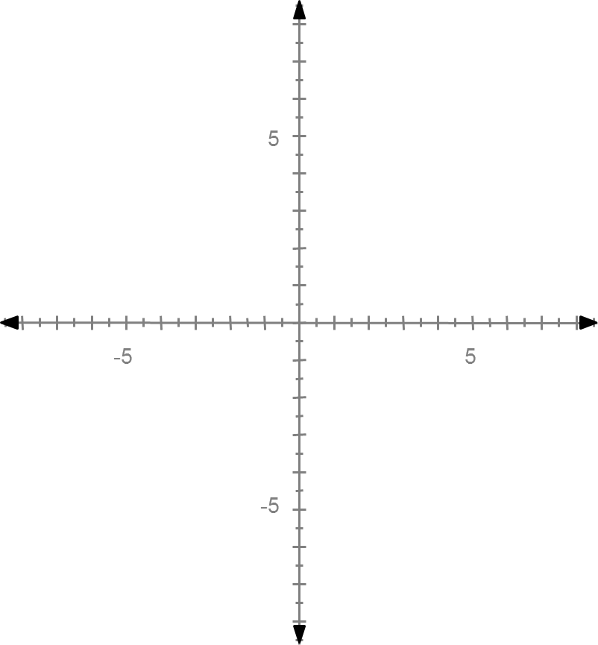
Relations
d. Graph:

Slide 10
Vocabulary
Domain: the set of input values for a function. (x-values)

Slide 11
Domain
Example:
Given the function:
{(1, 5), (2, -3), (3, 0), (4, 2)}
The domain is {1, 2, 3, 4}

Slide 12
Vocabulary
Range: the set of output values for a function. (y-values)

Slide 13
Range
Example:
Given the function:
{(1, 5), (2, -3), (3, 0), (4, 2)}
The range is {-3, 0, 2, 5}

Slide 14
Vocabulary
Linear Equation: an equation for which the graph is a straight line.

Slide 15
Linear Equation
Example:
y = 2x + 3

Slide 16
Vocabulary
Function table: a table used to organize the input numbers, output numbers, and the function rule.

Slide 17
Function Table
Example:
Given y = 2x + 3, create a function table.
x | y = 2x + 3 | y or f(x)

Slide 18
Function Table
Example:
Given y = 2x + 3, create a function table.
x | y = 2x + 3 | y or f(x)
-1 | y = 2(-1) + 3 | 1

Slide 19
Function Table
Example:
Given y = 2x + 3, create a function table.
x | y = 2x + 3 | y or f(x)
-1 | y = 2(-1) + 3 | 1
0 | y = 2(0) + 3 | 3

Slide 20
Function Table
Example:
Given y = 2x + 3, create a function table.
x | y = 2x + 3 | y or f(x)
-1 | y = 2(-1) + 3 | 1
0 | y = 2(0) + 3 | 3
1 | y = 2(1) + 3 | 5

Slide 21
Function Table
Example:
Given y = 2x + 3, create a function table.
x | y = 2x + 3 | y or f(x)
-1 | y = 2(-1) + 3 | 1
0 | y = 2(0) + 3 | 3
1 | y = 2(1) + 3 | 5
2 | y = 2(2) + 3 | 7

Slide 22
Vocabulary
Independent Variable: The independent variable is the input (x) value.
It is the value that you may choose.

Slide 23
Vocabulary
Note:
If time is an option, it will always be the independent variable.
Examples of time: month, day, year, minutes, seconds, hours,
etc.

Slide 24
Vocabulary
Dependent Variable: The dependent variable depends on the independent variable
It is the output (y) value.

