Slide 1

Totally
Transformed
Using Geometers Sketchpad

Slide 2
What happens In a rigid transformation?
Shape changes size and position
Shape changes size but not position
Shape changes position but not size
Shape doesn’t change at all
Notes:
Answer is 3.

Slide 3
What are the 3 types of Rigid transformations?
Rotation, Reduction, Reflection
Translation, Reflection, Dilation
Rotation, Reflection, Translation
Reflection, Rotation, Dilation
Notes:
Answer is 3. Dilations do not fit in this category because their size changes.

Slide 4
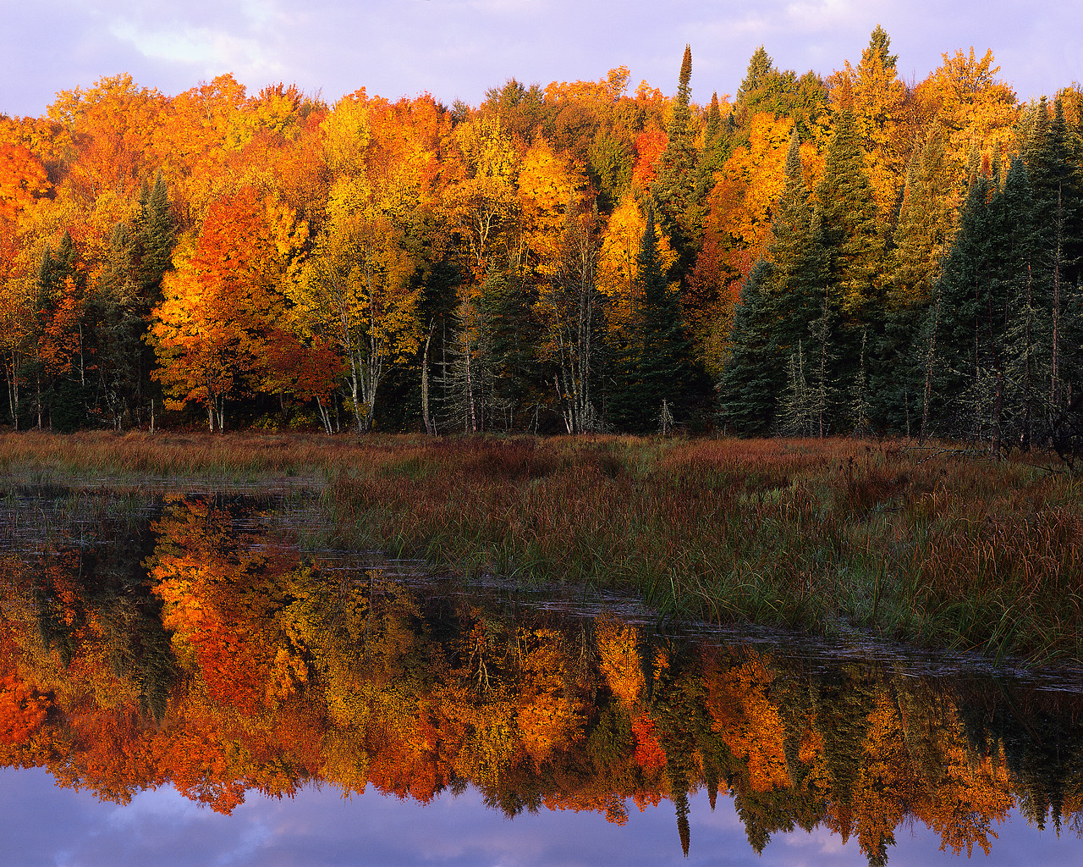
Notes:
Look at this picture. What type of rigid transformation does it illustrate? (reflection)

Slide 5
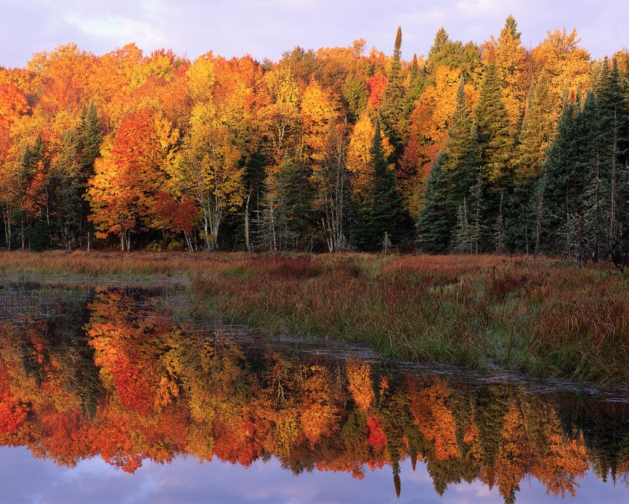
What transformation was illustrated in the picture?
Rotation
Reflection
Translation
Notes:
Answer is 2. How did the position of the mountain change? It flipped like a mirror image.

Slide 6

Notes:
Watch this picture. What type of rigid transformation is it? You must click in order for the picture to slide to the right.

Slide 7

What transformation was illustrated in the picture?
Rotation
Reflection
Translation
Notes:
Answer is 3. How did the position change? It slid to the right.

Slide 8

Notes:
Look at the pinwheel. What type of transformation does it illustrate?

Slide 9
What transformation was illustrated in the picture?
Rotation
Reflection
Translation
Notes:
Answer is 1. How did the position change? The pinwheel pieces turned at an angle.

Slide 10
Today we will …
Work cooperatively in groups
Explore what happens in each type of transformation
Use the program GeoGebra to make our discoveries
Make predictions
Record findings
Reflect on experience
If there is time…
Create fractals using transformations

Slide 11
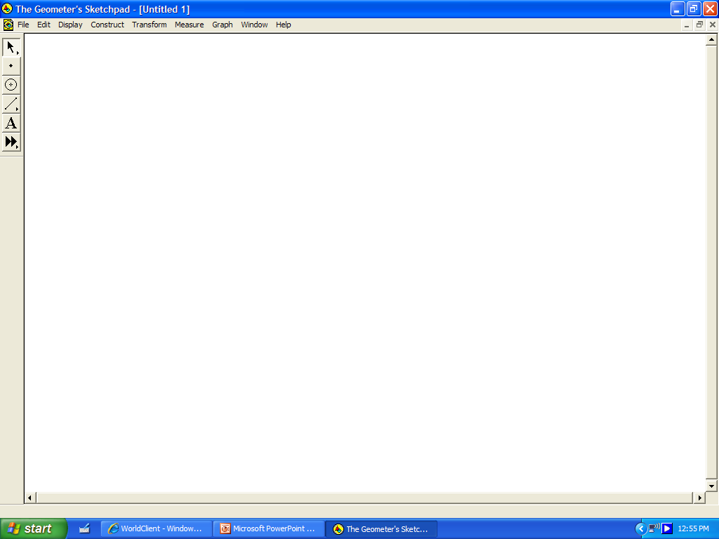
Using GeoSketchpad
Arrow Tool
Measuring Tools
Point Tool
Transformations
Segment Tool
Label Tool
Open a new sketch: Go to File: New Sketch
Arrow Tool is your default tool.
Use the Arrow Tool to select points.
Notes:
Discuss the different tools that will be used to create the transformations.

Slide 12
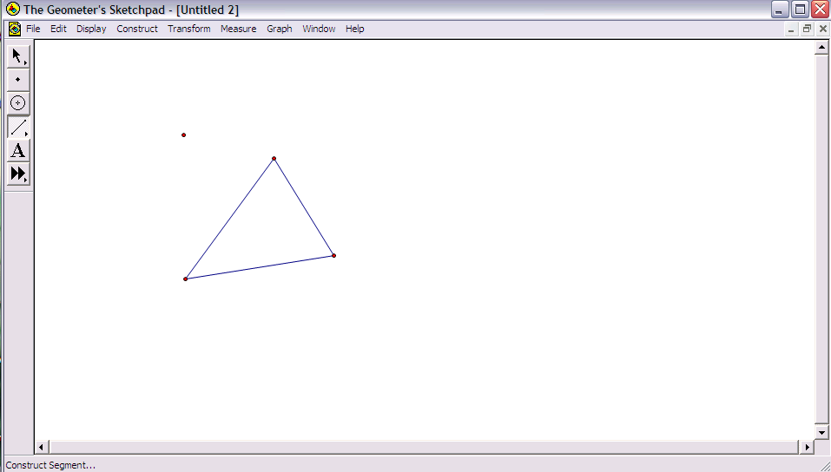
LETS PRACTICE
Notes:
Open Sketchpad. Practice some of the major tools with the students. Show them how to create a triangle and label it. It would be helpful to also show how to measure and move things. This will save time when they are on their own.

Slide 13
NOW IT’S YOUR TURN
Follow the directions on your sheet
Record all measurements in journal
Determine a definition
Draw an illustration
Notes:
Hand out direction packets and journals at this point. Each pair will get directions for translations and rotations. Tell students they will have about 15 – 20 minutes to complete this. If they finish early they may switch direction sheets with partner and create a second transformation. Go to next slide to explain journal

Slide 14
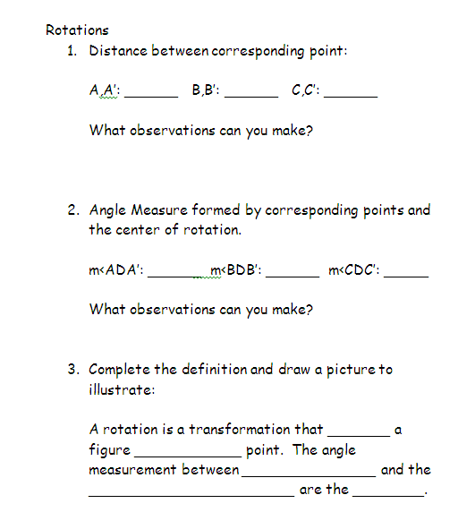
Record information in your journal
Notes:
Explain that while they are creating their transformations, they need to take certain measurements and make observations about them. For example for rotations they need to find distance between corrsp. Points. When they have finished with their transformation they need to use the information gathered to fill in the blanks of the definition.

Slide 15
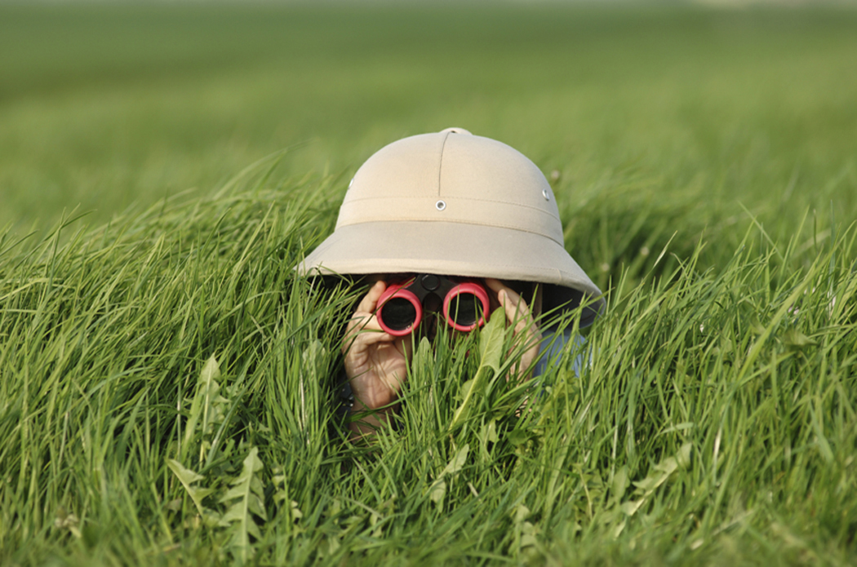
What did we discover?
Notes:
Starting with translation, have a group share information in next few slides.

Slide 16
TRANSLATION
Distance: A,A’ _____
B,B’ _____
C,C’ _____
Dragging the point what happened?
Notes:
Use pen tool to record answers.

Slide 17
TRANSLATION
A transformation that _______ each point of a figure the same _________ and in the same _______ .
slides
distance
direction
Notes:
Ask students if they know what should go in the blanks. Click for each answer to pop up.

Slide 18
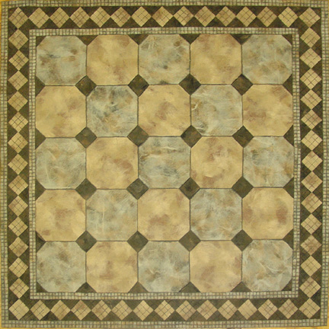
Can you find a translation in the tile?
Notes:
Using the pen tool have students come up and circle all of the translations they see.

Slide 19
Rotation
Distance: A,A’: _____
B,B’: _____
          C,C’: _____
ANGLES: <ADA’: _____
<BDB’: _____
          <CDC’: _____
Notes:
Use pen tool to record answers.

Slide 20
Rotation
A transformation that _______ a figure ________ a point. The angle measurement between ____________________
and the _________________
are the _____.
turns
around
corresponding points
center of rotation
same
Notes:
Ask students if they know what should go in the blanks. Click for each answer to pop up.

Slide 21

Can you find a rotation in the tile?
Notes:
Using the pen tool have students come up and circle all of the rotations they see.

Slide 22
LETS Create the reflection together
Notes:
Open Geometers Sketchpad on your computer and create the reflection as a class. Ask students to keep track of their measurements in the journal. When the reflection is done have students discuss what a possible definition of a reflection could be based on the measurements collected.

Slide 23
reflection
Distance: A,A’: _____
B,B’: _____
          C,C’: _____
ANGLES: <ADA’: _____
<BDB’: _____
          <CDC’: _____

Slide 24
Reflection
flip
A transformation that _____ a figure across the line of _________ forming a _____________ bisector with the segment joining the ___________________.
reflection
perpendicular
corresponding points

Slide 25
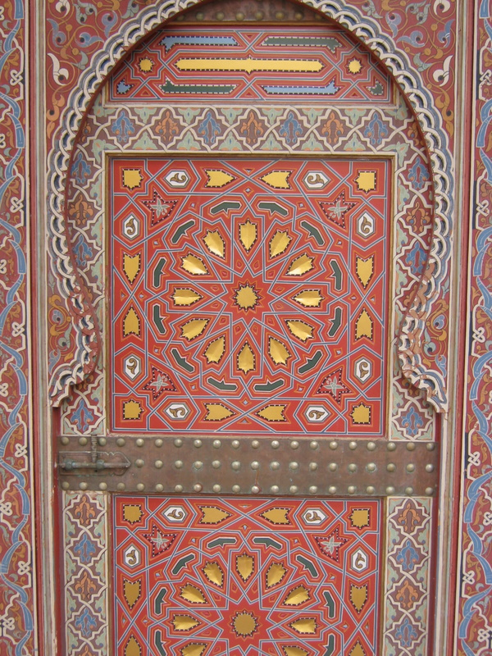
Can you find a reflection in the tile?
Notes:
Have students use pen tool to circle all reflections they see.

Slide 26
Transformation game
Player 1 spins arrow and lands on red
a. Look at key
b. Reflect up one block
c. Rotate 90 counter-
clockwise
d. Translate diagonally
Notes:
Show students how to play the game and then pass out a game bag for each pair. Give only 4-5 minutes to play. It is just to give them practice.

Slide 27
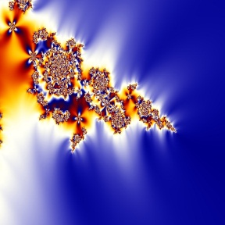

Fractal tiles
Notes:
To bring everything together today we are going to create fractal tiles. Does anyone know what a fractal is?

Slide 28
What are fractals?
Geometric figures built up from a simple shape by repeating the same changes at smaller and smaller scales. (recursion)
Notes:
Go over the 3 main characteristics of a fractal: self similarity, recursion, and zoom. If you look at the middle picture it is self similar because it is a triangle made up of smaller congruent triangles. Repeating the same step at each stage is called recursion.

Slide 29

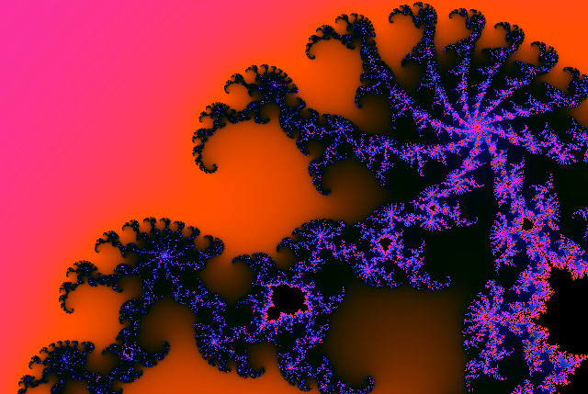
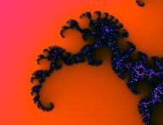
What are fractals?
Self-similar objects that look the same no matter to what stage you zoom.
Notes:
This is a computer generated fractal titled, “Elephant’s Ear”. If you take a smaller piece from it, the smaller piece looks exactly like the larger picture. I can continue to take smaller and smaller pieces and still see the original image. In a fractal when you zoom in or out to a different stage the object will look the same.

Slide 30
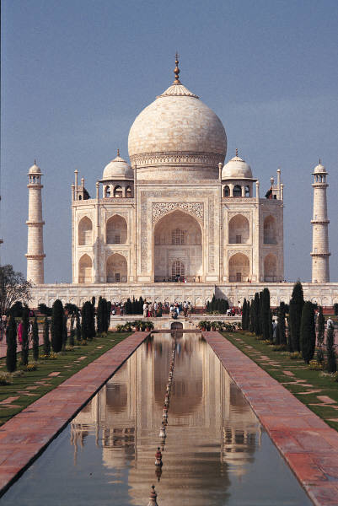
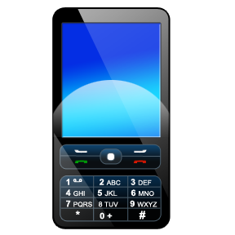


FRActals Can be found in …
MOVIES
TECHNOLOGY
ARCHITECHTURE
NATURE
Notes:
Explain that fractals are found just about anywhere. Star Wars was the first movie to use fractal technology in order to create realistic backgrounds. Today it is used in movies like Cars, 2012, Day After Tomorrow. Engineers use it to create smaller more efficient antennas for cell phones. You can also see fractal geometry in architecture and throughout nature. Tell them that they may even work with fractal geometry in a future career.

Slide 31

Creating stage 1 Translation
Translate
one tile up
Translate
one tile right
Notes:
Ask students to get out one small grid and 3 pictures. One of the pictures demonstrates stage 0. We are going to create stage 1 using translation and rotation. Show them how to translate

Slide 32
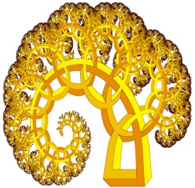
Creating stage 1 Rotation
Rotate the top
90 degrees
clockwise
Rotate the bottom
right 90 degrees
clockwise
Notes:
Once they have translated pieces they will rotate. This is a completed stage 1. When done they can glue on grid and create 2 more each. They will need 3 stage 1 grids to create stage 2.

Slide 33

Creating stage 2 Translation
Translate one grid up and one grid to the right
Notes:
To create stage two, we repeat the same process (recursion). Translate a piece up and a piece to the right.

Slide 34
Rotate top 90
Rotate bottom right 90
Notes:
Have them create stage two. If there is time they can make another stage 2 in their group in order to create a stage three. If no time is left you can show them stage

Slide 35
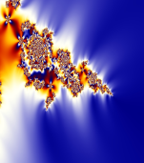

To create Stage 3 repeat the process
Notes:
Students can continue adding stages and the tile can be displayed in a hall or classroom bulletin board.

