Slide 1
Dividing Monomials
Tammy Wallace
Varina High

Slide 2
Dividing Monomials
multiplication
The opposite of division is ______________. And when multiplying monomials, the rule tells says to ________ the coefficients and _____ the exponents.
Because division and multiplication are opposites, when dividing monomials, ______ the coefficients and ________ the exponents.
multiply
add
divide
subtract

Slide 3
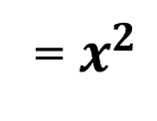
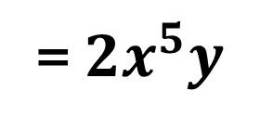
DIVIDING MONOMIALS: Divide the coefficients and subtract the exponents
NUMBERS | VARIABLES | PRODUCT OF NUMBERS AND VARIABLES
$\frac{18}{3}$ = _____ | $$\frac{x^{5}}{x^{3}}$$ What part of the rule should be applied? = ($x^{____−_____}$ ) | $\frac{6x^{9}y^{2}}{3x^{4}y}$ What part(s) of the rule should be applied? $6÷3$= ____ = $\frac{____x^{9}y^{2}}{x^{4}y}$ = ${____x}^{___−___}y^{____−____}$
Subtract exponents
Adding the coefficients and subtracting the exponents.
$$2$$
$$6$$
$$5$$
$$3$$
$$2$$
= $x^{2}$
$$9$$
$$4$$
$$2$$
$$1$$
$$2$$
= $2x^{5}y$

Slide 4
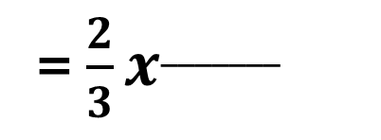
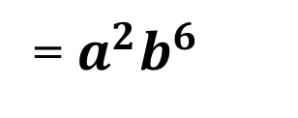


DIVIDING MONOMIALS: Divide the coefficients and subtract the exponents
NUMBERS | VARIABLES | PRODUCT OF NUMBERS AND VARIABLES
Sometimes, reducing is easier than dividing. $\frac{6}{24}$ = _____ | $$\frac{a^{4}b^{7}}{a^{2}b}$$ What part of the rule should be applied? = $a^{_______−_______}b^{_______−_______}$ | $\frac{4x^{5}}{6x^{2}}$ What part(s) of the rule should be applied? $\frac{4}{6}=$
Adding the coefficients and subtracting the exponents.
Subtract exponents
$$\frac{2}{3}$$
$$4$$
$$2$$
$$7$$
$$1$$
$$\frac{1}{4}$$
= $\frac{2}{3}x^{_______}$
= $a^{2}b^{6}$
$$5−2$$
= $\frac{2x^{3}}{3}$

Slide 5
Negative Exponents
When simplifying monomials, the value of an exponent can NEVER be ______ _____.
After simplifying, ONLY take the ______________ of each _____ that has a ___________ exponent.
This will turn ___________ exponents _______ __.
negative
reciprocal
term
negative
negative
positive

Slide 6



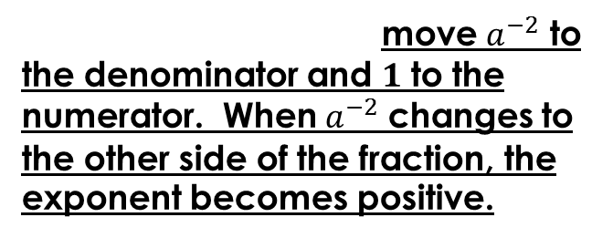
Negative Exponents
$$a^{−2}$$ | $$\frac{1}{a^{−2}}$$
Turn the term into a ___________. If it is already in that format, move to the next step. = ____________ To find the reciprocal, = ____________ | If the negative term is in the _________________, find it’s reciprocal by Again, when changing a negative term to other side of the fraction, this makes the negative exponent = ____________
fraction
denominator
$$\frac{a^{−2}}{1}$$
moving $a^{−2}$ to the numerator and $1$ to the denominator.
move $a^{−2}$ to the denominator and $1$ to the numerator. When $a^{−2}$ changes to the other side of the fraction, the exponent becomes positive.
positive.
$$\frac{a^{2}}{1}= a^{2}$$
$$\frac{1}{a^{2}}$$

Slide 7
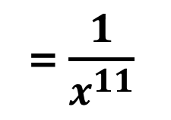


Negative Exponents
$$\frac{x^{2}}{x^{13}}$$ | $$\frac{12x^{2}}{15x^{−5}}$$
How do you simplify this monomial? $$= x^{_____−______}$$ | 1) Change any 3) What operation is done next?
Simplify the coefficients.
Subtract the exponents.
$$\frac{12}{15}= \frac{4}{5}$$
negative exponents to postive.
$$2$$
$$13$$
$$=\frac{4x^{2}x^{5}}{5}$$
= $\frac{x^{−11}}{1}$
= $\frac{1}{x^{11}}$
= $x^{−11}$
negative exponents to postive.
$$=\frac{4x^{7}}{5}$$
$$=\frac{4x^{2}x^{5}}{5}$$

Slide 8
Zero Exponents
When simplifying monomials, if the exponent of a term simplifies to equal zero, the value of that term simplifies to equal
1

Slide 9

Simplify: $\frac{−8x^{6}y^{2}}{2x^{3}y^{2}}$
$$=\frac{{−4x}^{6}y^{2}}{x^{3}y^{2}}$$
$$=−4x^{3}y^{0}$$
$$={−4x}^{3}\left(1\right)$$
$$={−4x}^{3}$$

Slide 10

Simplify: $\frac{{\left(5x^{4}y^{−8}z\right)}^{0}}{1}$
$$=\frac{1}{1}$$
$$=1$$

Slide 11

Simplify: $\frac{−9x^{8}}{−6x^{2}y^{6}}$
$$=\frac{3x^{8}}{2x^{2}y^{6}}$$
$$=\frac{3x^{6}}{2y^{6}}$$

