Slide 1
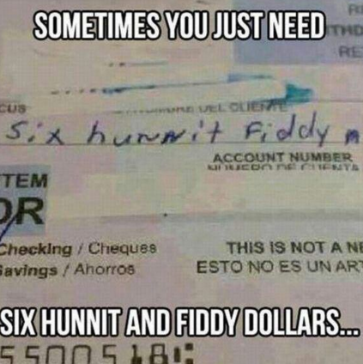
Multiplying and Dividing Polynomials
Tammy Wallace
Varina High

Slide 2
Recall
Recall a monomial is a term with just term, a number, or the product of numbers and variables.
A BINOMIAL is the sum or difference of two monomials.
A TRINOMIAL is the sum or difference of three monomials.

Slide 3
Multiplying Polynomials
MULTIPLYING POLYNOMIAL can be represented several different ways.
Monomials x Binomial | Monomial x Trinomial
$$2(x+4)$$
x$(2x^{2}+3x−1)$
Binomial x Binomial | Binomial x Trinomial
$$(x+3)(x−2)$$
$(x−1)(x^{2}+2x+4$)

Slide 4
Multiplying Polynomials
When multiplying polynomials use the distributive property to completely simplify each expression.
MONOMIALS X BINOMIALS
$$2\left(x+4\right)$$
$$3(x−1)$$
 | x | 4
2
$$2\left(x+4\right)=$$
$$2x+8$$
Use the box method
$$2x$$
$$8$$
 | x | -1
3
Use the box method
$$3\left(x−1\right)=$$
3$x−3$
3$x$
$$−3$$

Slide 5
Monomial x Trinomial
Simplify $2x(x−y+5)$
$$2x(x−y+5)$$
Use the box method
 | x | -y | $$5$$
2x
$$2x^{2}$$
$$−2xy$$
$$10x$$
$$2x\left(x−y+5\right)=$$
$$2x^{2}−2xy+10x$$

Slide 6
Monomial x Trinomial
Simplify $−{xy}^{2}\left(x^{2}−2x+4\right)$
$$−{xy}^{2}(x^{2}−2x+4)$$
 | $$x^{2}$$ | -2x | $$4$$
$${−xy}^{2}$$
Use the box method
$$−2x^{3}y^{3}$$
$$2x^{2}y^{2}$$
$${−4xy}^{2}$$
$$−{xy}^{2}(x^{2}−2x+4)=$$
$$−2x^{3}y^{2}+2x^{2}y^{2}−4xy^{2}$$

Slide 7
Binomial x Binomial
Simplify $(x+3)(x+7)$
$(x+3)(x+7)$
Group all like terms and combine for the final answer.
$$x^{2}+3x+7x+21$$
$$x^{2}+10x+21$$
Use the box method
 | x | 3
x
7
$$x^{2}$$
$$3x$$
7$x$
21

Slide 8
Binomial x Binomial
Simplify $(3x−5)(5x+2)$
Group all like terms and combine for the final answer.
$${15x}^{2}−25x+6x−10$$
$${15x}^{2}−19x−10$$
 | 3x | -5
5x
2
$${15x}^{2}$$
$$−25x$$
6$x$
-10

Slide 9
Binomial x Binomial
Simplify $(2x−1)(2x+1)$
Group all like terms and combine for the final answer.
$${4x}^{2}−2x+2x−1$$
$${4x}^{2}−1$$
 | 2x | -1
2x
1
$${4x}^{2}$$
$$−2x$$
2$x$
-1

Slide 10
Special Binomials
Simplify $({x−3) }^{2}$
This binomial is being squared. When anything is raised to a power,
$$({x−3) }^{2}=\left(x−3\right)(x−3)$$
= $x^{2}−3x−3x+9$
= $x^{2}−6x+9$
multiply the binomial by itself based on the outside exponent.
 | x | -3
x
-3
$$x^{2}$$
$$−3x$$
-3$x$
9

Slide 11
Trinomial x Trinomial
Simplify $(2x+1)\left(x^{2}−3x+4\right)$
 | $$x^{2}$$ | -3x | $$4$$
$$2x$$
$$1$$
$$2x^{3}$$
$$−6x^{2}$$
$$8x$$
$$x^{2}$$
$$−3x$$
$$4$$
$$= 2x^{3}−6x^{2}+x^{2}+8x−3x+4$$
$$= 2x^{3}−5x^{2}+5x+4$$

Slide 12
Trinomial x Trinomial
Simplify $(2x−5)\left(x^{2}−5x+4\right)$
 | $$x^{2}$$ | -5x | $$4$$
$$2x$$
$$−5$$
$$2x^{3}$$
$$−10x^{2}$$
$$8x$$
-5$x^{2}$
25$x$
$$−20$$
$$= 2x^{3}−10x^{2}−5x^{2}+8x+25x−20$$
$$= 2x^{3}−15x^{2}+23x−20$$

Slide 13
Dividing Polynomials
When dividing polynomials, rewrite the expression by breaking it up based on the number of terms in the numerator.
After breaking up the expression, simplify each term.

Slide 14
Dividing Polynomials
Problem | Break up | Simplify
$$\frac{10x+6}{2}$$
$\frac{10x}{2}+\frac{6}{2}$
$5x+3$
Problem | Break up | Simplify
$$\frac{15y^{3}+6y^{2}−3y}{3y}$$
$\frac{15y^{3}}{3y}+\frac{6y^{2}}{3y}−\frac{3y}{3y}$
$$5y^{2}+2y−1$$

Slide 15
Dividing Polynomials
Sometime division can be expressed like . Rewrite the problem as a fraction and solve like normal.
Problem | Rewrite | Break up | Simplify
$$\frac{2x^{2}+32}{x^{2}}$$
$$\frac{2x^{2}}{x^{2}}+\frac{32}{x^{2}}$$
$$2+\frac{32}{x^{2}}$$

