Slide 1
Take Down:
Algebra Review
1st 9 weeks
Created by:
Classroom Ms. Finnegan
© Classroom Ms. Finnegan

Slide 2
SET-UP DIRECTIONS
Set up trash can basket. I divide the room, or clear a space to create a shooting range. I place two markers on the ground for 2 point and 3 point goals. I use squishy balls or paper balls to shoot the hoops.
Name/number each team. I have assigned names or numbers to groups, and I have also let them choose a name; often times it is more beneficial for time’s sake to choose for them. The game is designed for 6 teams total. Personally, four or five groups of three to five students has worked best for me. I bumped it to six to accommodate larger class sizes; or delete/move slides to fit the needs of your smaller class. I have used extra slides as bonus questions many times in the past.
Each team receives 15 points to begin. I have used x’s, or bars, to represent the number of points. I place these points such that they are easily visible to all students; usually on the white board in the front of class. I will draw dividers between each team, and their points, so no mistakes are made. Students will need to get to these points easily as they will be responsible for erasing points.
Give teams one whiteboard, or make sure they have space to write on a mounted whiteboard. This is essential! I DO NOT accept answers that are yelled out to me, or answers that I cannot read. This eliminates the, “you didn’t hear me right” or “you didn’t read my answer right” arguments. Have students select a group scribe, to write all answers on the given whiteboard.
Give each student an answer document. All students are responsible for answering each question, even if it is not specific to their group. This is needed both for purposes of the game, and it gives me an opportunity to look over their work to see if extra practice or remediation is needed.
STOP!
© Classroom Ms. Fit, 2016

Slide 3
GAME DIRECTIONS
Each team will start with 15 points. The team with the most points left at the end of the game wins.
Each team will have a specific question to answer in two minutes. All teams will work on the same question. Work will be shown on the answer document provided.
If the first answer is incorrect, the team has the remaining time to come up with the correct answer.
At the end of two minutes, students must put all dry erase markers down.
The answer MUST be written on the whiteboard, and it must be legible, or it will be considered wrong. There will be NO time given to rewrite an answer.
If the answer is correct the team will be awarded 2 TAKE DOWN points from any team(s) they like. Example: two points could be taken from one team, or one point could be taken from two teams.
The team can then designate a shooter, or rotate shooters, for the opportunity to earn up to three more TAKE DOWN points. If the basket is missed, no points are awarded or taken. If the basket is made, the team will be awarded two, or three, TAKE DOWN points to remove using the guidelines stated above.
STOP!
DIRECTIONS CONTINUED ON NEXT SLIDE…..
© Classroom Ms. Fit, 2016

Slide 4
GAME DIRECTIONS
If the final answer is incorrect the following teams, in numerical/team order, will have an opportunity to answer.
In order to answer, the the team must “buy-in” by giving up two of their own points. Teams not willing to buy-in cannot answer, and the following team will have an opportunity to buy-in and answer. If no team buys-in, then it is assumed no one understands the problem and it will be discussed as a class.
Teams should not be afraid to buy-in, many teams have won using this strategy.
If a team buys-in, and the answer is correct, the point and shooting rules apply as stated before. Points will not be added back to their own team. TAKE DOWN points can only be used to take points away from other teams.
If a team buys-in, and the answer is incorrect, no TAKE DOWN points are awarded and the team cannot shoot for points.
Once the question is answered, or reviewed as a class, the following question goes to the next team in slide order; even if it was a team that bought in on the previous question.
A team out of points can regain by answering their next question correct. Max points back is two. Additional points, after shooting, are for taking away from other teams only.
STOP!
© Classroom Ms. Fit, 2016
GOOD LUCK!!

Slide 5
TEAM: 1 QUESTIONS: GROUP A
SAMPLE SLIDE
Team number/name
Two minute countdown timer.
Click here for sample START sound
STOP!
Click here for sample END sound – there will be three in a row
© Classroom Ms. Fit, 2016

Slide 6
GET READY!
When the slide changes, and the alarm sounds, the game has begun…….
GOOD LUCK!!
STOP!
© Classroom Ms. Fit, 2016

Slide 7
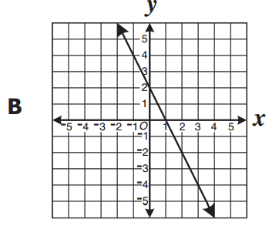
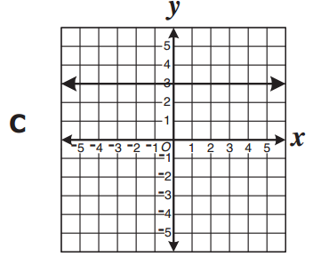
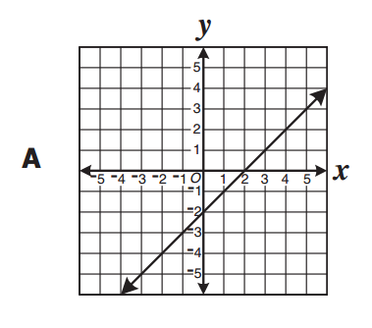
TEAM: 1 QUESTIONS: GROUP A
STOP!
© Classroom Ms. Fit, 2016

Slide 8
STOP!
© Classroom Ms. Fit, 2016

Slide 9
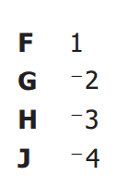
TEAM: 2 QUESTIONS: GROUP A
STOP!
© Classroom Ms. Fit, 2016

Slide 10
STOP!
© Classroom Ms. Fit, 2016

Slide 11
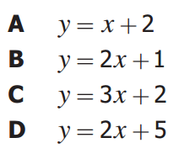
TEAM: 3 QUESTIONS: GROUP A
STOP!
© Classroom Ms. Fit, 2016

Slide 12
STOP!
© Classroom Ms. Fit, 2016

Slide 13
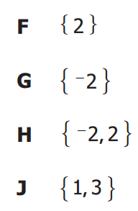
TEAM: 4 QUESTIONS: GROUP A
STOP!
© Classroom Ms. Fit, 2016

Slide 14
STOP!
© Classroom Ms. Fit, 2016

Slide 15
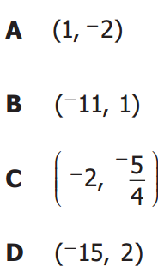
TEAM: 5 QUESTIONS: GROUP A
STOP!

Slide 16
STOP!
© Classroom Ms. Fit, 2016

Slide 17
TEAM: 6 QUESTIONS: GROUP A
STOP!
© Classroom Ms. Fit, 2016

Slide 18
STOP!
© Classroom Ms. Fit, 2016

Slide 19
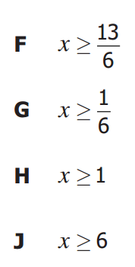
STOP!

Slide 20
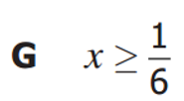
STOP!
© Classroom Ms. Fit, 2016

Slide 21
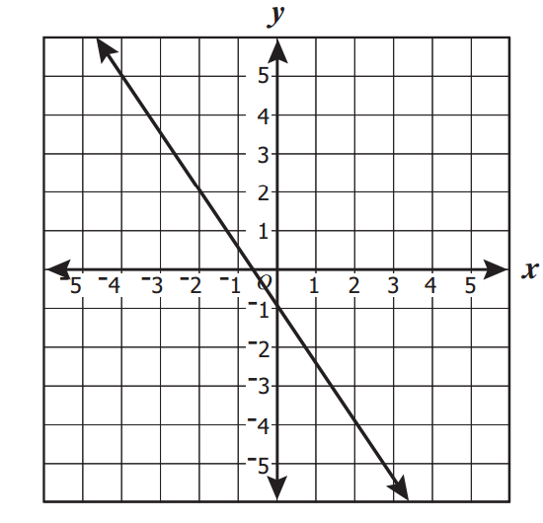
STOP!

Slide 22
The missing sides can be found by using trigonometry.
STOP!
© Classroom Ms. Fit, 2016

Slide 23
STOP!
© Classroom Ms. Fit, 2016

Slide 24
STOP!
© Classroom Ms. Fit, 2016

Slide 25
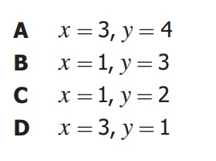
STOP!
© Classroom Ms. Fit, 2016

Slide 26
STOP!
© Classroom Ms. Fit, 2016

Slide 27
STOP!
© Classroom Ms. Fit, 2016

Slide 28
STOP!
© Classroom Ms. Fit, 2016

Slide 29
STOP!
© Classroom Ms. Fit, 2016

Slide 30
STOP!
© Classroom Ms. Fit, 2016

Slide 31
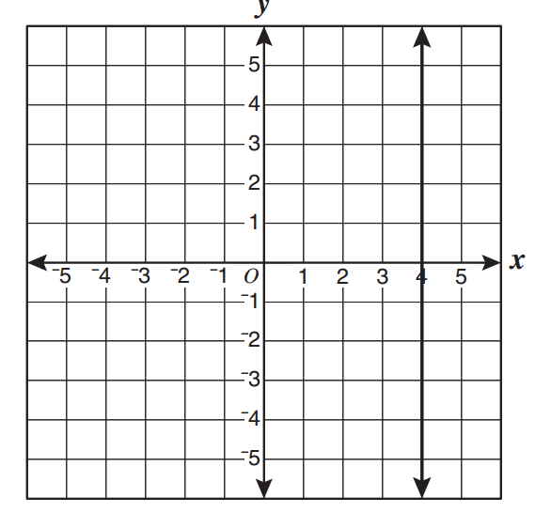
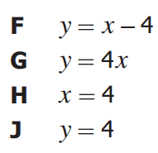
STOP!
© Classroom Ms. Fit, 2016

Slide 32
STOP!
© Classroom Ms. Fit, 2016

Slide 33
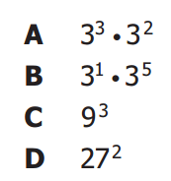
TEAM: 2 QUESTIONS: GROUP C
STOP!
STOP!

Slide 34
STOP!
© Classroom Ms. Fit, 2016

