Slide 1
Perpendicular: Congruent:
Supplementary:
Complimentary:
Linear pair:

Slide 2
E
D
a
Given:
a b
DCE = FEC
Prove:
ADC = CFE
b
F
C
Statement
Reason

Slide 3
Find the distance between (1,2), (5, 9)

Slide 4
Find the missing endpoint if b is the midpoint c(-5, 4) b(-2, 5)

Slide 5
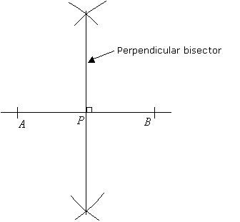
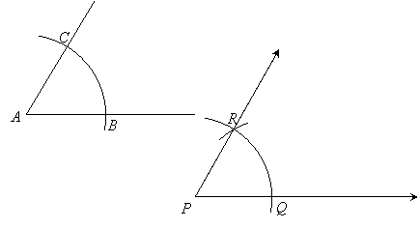
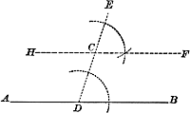
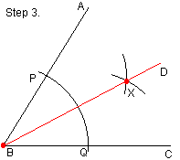
DESCRIBE!

Slide 6
Find X
120
2x - 10
2x
4x + 108
3x + 30

Slide 7
Formulas you SHOULD know!!!
AREA of CIRCLE
AREA OF SQUARE
AREA OF RECTANGLE
AREA OF TRIANGLE
CIRCUMFERENCE OF CIRCLE
PERIMETER OF SQUARE
PERIMETER OF RECTANGLE
PERIMETER OF TRIANGLE

Slide 8
ABC = DEF LIST THE CONGRUENT PARTS

Slide 9
CAN YOU MAKE A TRIANGLE?
1,2,3
100,140,239
46, 23, 20
33, 16, 18

Slide 10
WRITE A PROOF
B
Given: CE bisects BED
Prove: ECB = ECD
C
E
Statement
Reason
D

Slide 11
If a circle is inscribed in an equilateral triangle with side length 6, what is the circumference of that circle?

Slide 12
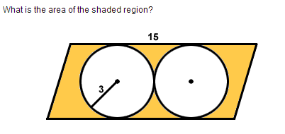

Slide 13
What is the area of a triangle with side lengths of 9, 40, and 41?

Slide 14
If the lengths of a triangle are 16, 30, and 34, what is its most specific classification?

Slide 15
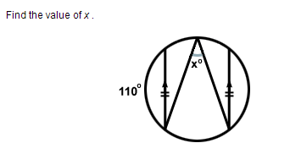

Slide 16
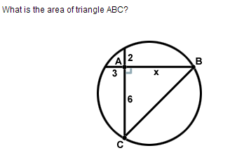

Slide 17
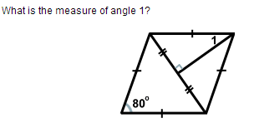

Slide 18
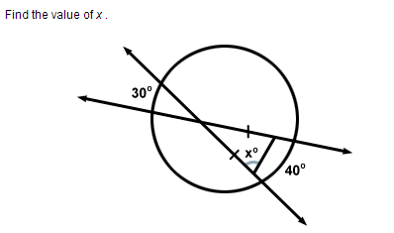

Slide 19
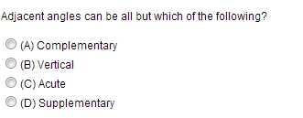
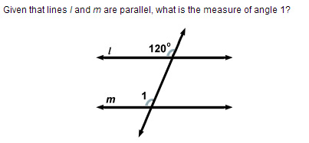

Slide 20
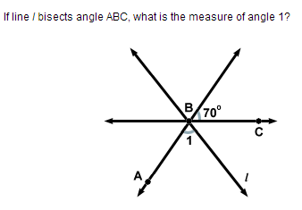

Slide 23
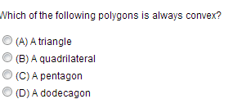
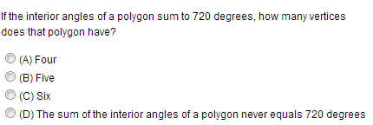

Slide 24
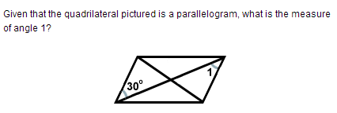

Slide 25
What type of problem is this ? Should you draw a picture?

