Slide 1
Geometry Review PPT Finnegan 2013
SOL
G.10

Slide 2
A building in the shape of a pentagon is regular and has 50 feet long walls. What interior angles are formed when two of the walls meet?

Slide 3
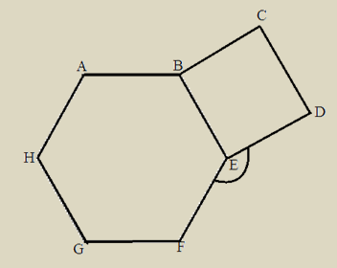

Slide 4
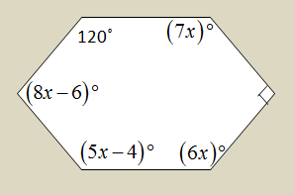
In the hexagon, find the value of $x$.

Slide 5
In a 33-sided polygon, what is the sum of the interior angles?

Slide 7
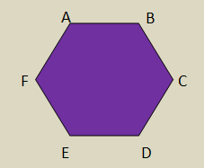

Slide 8
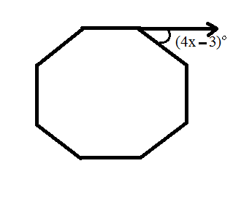
Directions: After showing your thinking, write your answer in the box. Round to the nearest degree.
Find the value of $x$ in the regular octagon.

Slide 9
Directions: After showing your thinking, write your answer in the box as a whole number.
If a regular polygon has an interior angle of 147°, how many sides does the polygon have?

Slide 10
An exterior angle in a regular polygon measures 14.4°. How many sides does the polygon have?

Slide 11
Directions: After showing your thinking, write your answer in the box as a whole number.
The sum of the interior angles in a polygon is 3,600°. How many sides does the polygon have?

