Slide 1
Geometry Review PPT Finnegan 2013
SOL
G.11

Slide 2
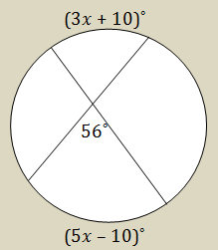
Find the value of $x$ for the intersecting chords in the diagram.

Slide 3
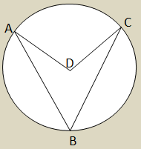
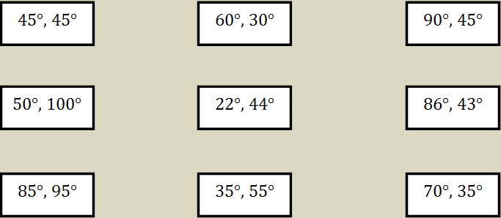

Slide 4
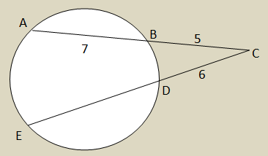

Slide 5
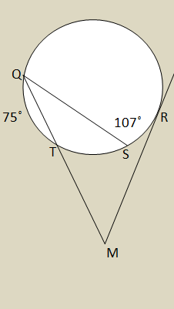

Slide 6
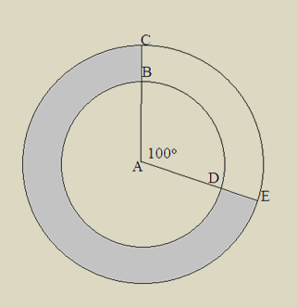

Slide 7
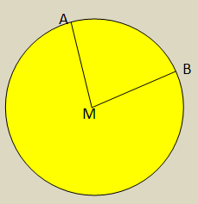

Slide 8
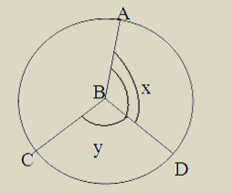

Slide 9
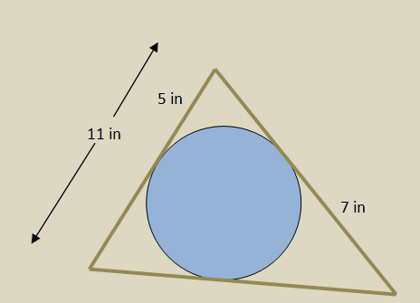
A circular window will have a decorative design made of a wood strip surrounding it, formed by connecting tangent lines. How many inches of wood strip is needed to complete the design?

Slide 10
A bike tire is being measured for new tubing that will cover the outside rim. If the wheel is 26 inches (the diameter), how many inches of wheel tubing will be needed to go entirely around the wheel?

