Slide 1
Geometry Review PPT Finnegan 2013
SOL
G.12

Slide 3
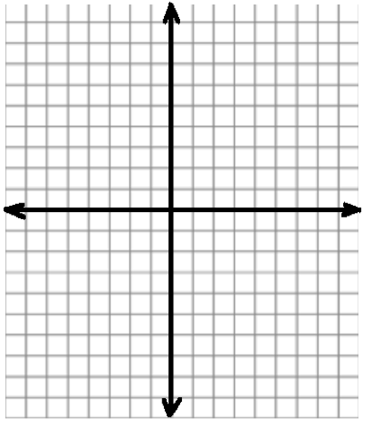
Directions: Draw a point on the graph then provide the coordinates in the boxes below.
Given the following standard equation for circle $A$, ($x$ – 4)² + ($y$ + 2)² = 9, what are the coordinates of the center?

Slide 4
Directions: After showing your thinking, write your answer in the box. Your answer should be in simplest form.
Circle $P$ has center $P$ at (9, $−$1) and a point ($−$3, 4) is on the circle. Use the distance formula to find the radius of the circle.

Slide 5
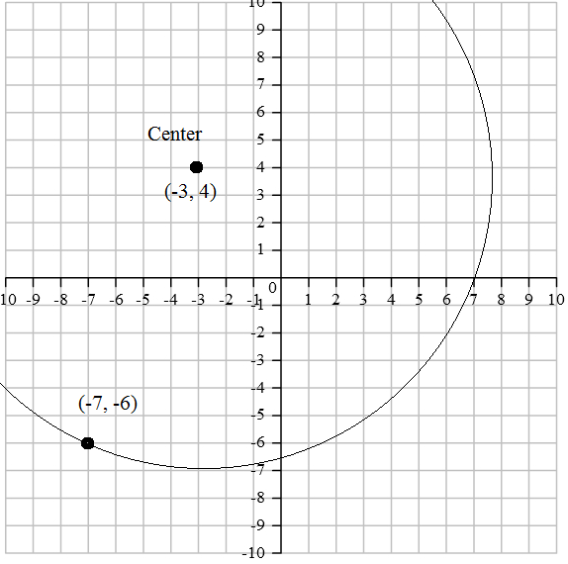
Directions: After showing your thinking, write your answer in the box. Your answer should be in simplest radical form.
Find the diameter of the circle in the diagram.

Slide 6
Directions: After showing your thinking, highlight the box you want to select. You must select all correct answers.
The center of circle $A$ is ($−$2, $−$5) and the radius is 4. Which points would land on circle $A$?

Slide 7
Directions: After showing your thinking, highlight the box you want to select. You must select all correct answers.
The center of a circle is (3, $−$2) and (4, 1) is on the circle. Which points would also land on the circle?

Slide 8
Given the equation of a circle in standard form ($x$ – 40)² + ($y$ + 10)² = 100. If $m$ represents the $x$ coordinate of the center of the circle, $n$ represents the $y$ coordinate of the center of the circle and $r$ represents the radius of the circle, find the result of the following expression:
$$\left(m−n\right) ● r=$$

Slide 9
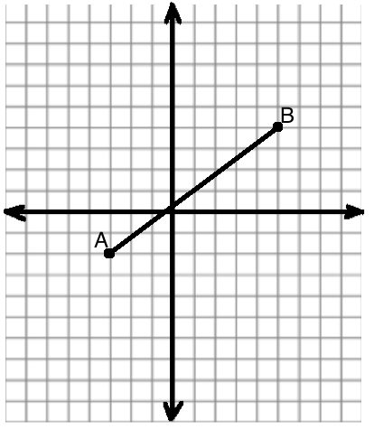
Directions: After showing your thinking, write your answer in the boxes provided.
In the diagram, $\overline{AB}$ is a diameter. Identify the center and the radius.

Slide 10
Directions: After showing your thinking, write your answer in the box.
The center of the circle is at point (0, 3) The point ($−$2, $−$1) is on the circle. Complete the equation of the circle.

Slide 11
Given the circle with the center at the origin and the point (8, 6) is on the circle. Identify the radius of the circle, using the Pythagorean Theorem.

