Slide 1
Geometry Review PPT Finnegan 2013
SOL
G.14

Slide 2
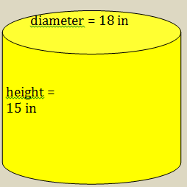
Directions: After showing your thinking, write your answer in the box. Your answer should be rounded to the nearest whole number. Use $π$ = 3.14.
Find the total surface area of the cylinder.

Slide 3
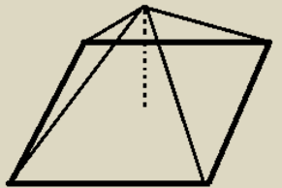
Directions: After showing your thinking, write your answer in the box.
A square base pyramid has a base area of 64 square centimeters. The height of the pyramid is 3 centimeters. What is the surface area of the pyramid?

Slide 4
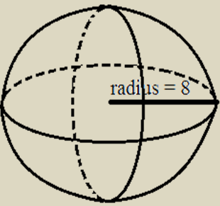
Directions: After showing your thinking, write your answer in the box. Leave your answer in terms of $π$.
Find the total surface area of the sphere.

Slide 5
Directions: After showing your thinking, write your answer in the box. Your answer should be provided as an improper fraction. Do not use mixed numbers.
A paperweight made of glass is in the form of a square pyramid. How many cubic inches of glass are needed for a pyramid that has a base length of 5 inches and a height of 8 inches?

Slide 6
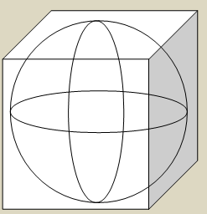
Directions: After showing your thinking, write your answers in the boxes provided. You must complete each box. Round your answer to the nearest whole number. Use $π$ = 3.14.
A sphere fits perfectly inside a cube that has side lengths of 20 inches. How much space is left over that is not taken up by the sphere?

Slide 7
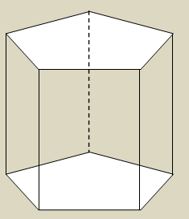
A pentagonal prism has a base area of 85 square inches. What is the height of the prism in order for the volume to be 1,020 cubic inches?

Slide 8
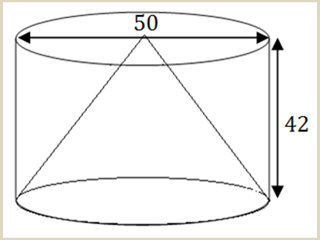
Directions: After showing your thinking, write your answer in the box. Your answer should be rounded to the nearest whole number. Use $π$ = 3.14.
A cone sites inside a cylinder, where they share the same base and the same height. How much space does the cone take up?

Slide 9
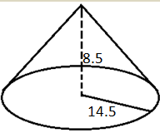
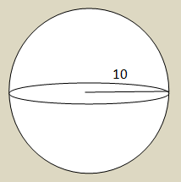
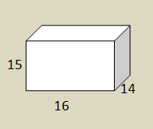
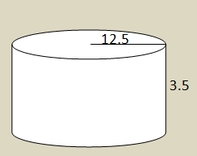
Directions: Circle the box you want to select.
Which two figures have the same surface area? (figures not drawn to scale)

Slide 10
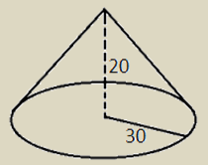
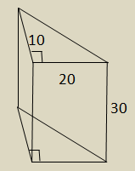
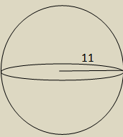
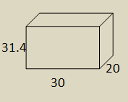
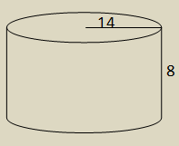
Directions: Circle the box you want to select. You must select all correct answers.
Which figures have the same volume as the cone shown below? (figures not drawn to scale)

Slide 11
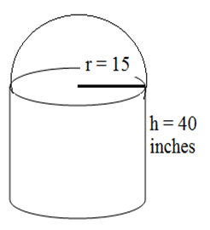
Directions: After showing your thinking, write your answer in each box. Leave your answer in $π$ form.
Paint is being used to recover the surface of a lawn ornament, formed by placing a hemisphere on top of a cylinder that has the same diameter. The bottom of the cylinder is not painted, but the rest of the exposed surface is covered by paint. How many square inches of paint is used?

