Slide 1
Geometry Review PPT Finnegan 2013
SOL
G.14
Finnegan Geometry
Review 2013

Slide 2
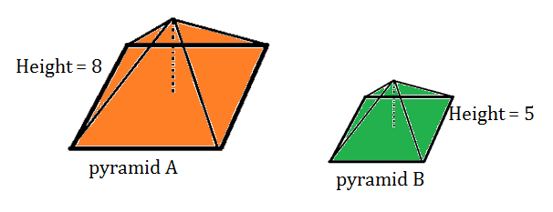
What is the ratio of volume of pyramid B to volume of pyramid A?

Slide 3
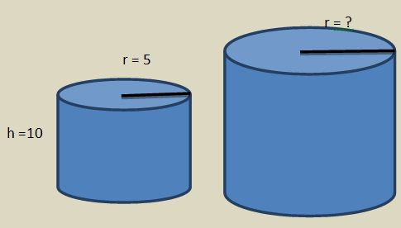
If the volume of the larger cylinder is 2,250 $π$ square units, what is the radius of the larger cylinder?

Slide 4
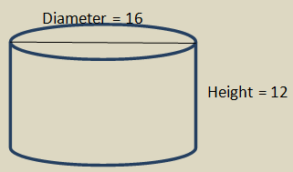
Directions: After showing your thinking, write your answer in the box.
If the diameter of the cylinder is doubled, how many times bigger is the volume?

Slide 5
The radius of this sphere is 20 centimeters. If the radius is tripled, how many times bigger is the volume than the original volume?
r = 20

Slide 6
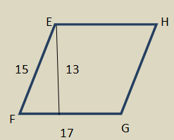
In parallelogram EFGH, EF = 15 cm, FG = 17 cm, and the height is 13 cm. How will the area of the parallelogram change if FG is doubled?

Slide 7
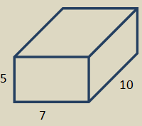
Directions: After showing your thinking, complete the missing information in the table below.
The volume of this rectangle prism is changed from its current volume to 1,225 cubed units by changing one measurement.

Slide 8
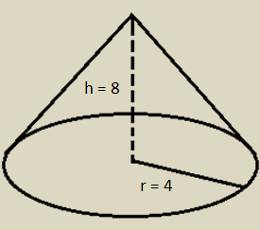
Directions: After showing your thinking, write your answer in the box.
If the volume of the cone after the height is changed is 384 $π$ cubed units, what is the new height?

Slide 9
The area of this circle after the radius is multiplied by 8 is 5,184 $π$ square units. What is the original radius of the circle?

Slide 10
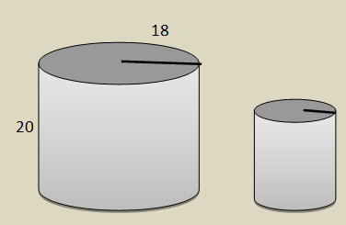
Directions: After showing your thinking, write your answer in the box.
Two similar cylindrical canisters are being used for storage in the kitchen. If the second canister will hold $\frac{1}{4}$ as much material as the first canister, what is the height of the second canister?

Slide 11
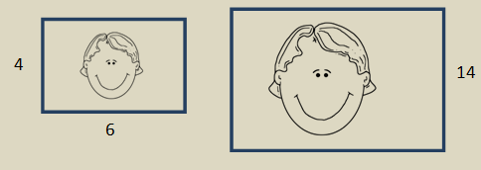
Directions: After showing your thinking, write your answer in the box.
A 4 x 6 photograph is being enlarged to be placed in a larger frame. If the width of the enlarged picture is 14 inches, what is the length?

