Slide 1
Geometry Review PPT Finnegan 2013
SOL
G.2
Parallel Lines

Slide 2
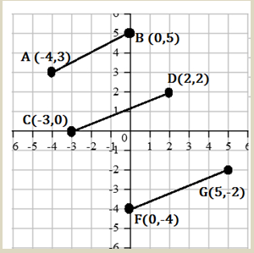
Directions: After showing your thinking, write your answer in the empty boxes. You may use the choices provided in the shaded box.
Given the following coordinates, determine which lines are parallel.

Slide 3
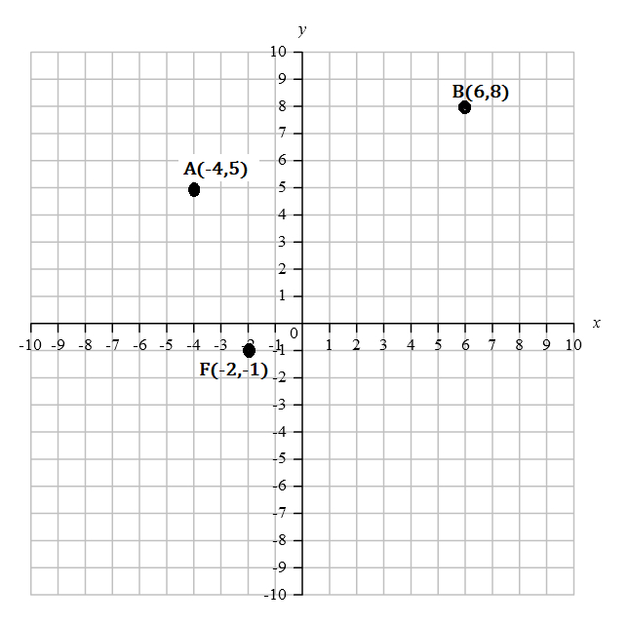
Line $AB$ has endpoints $A(−4, 5)$ and $B(6, 8)$. $F$ has coordinates $(−2, −1)$. Graph possible coordinates for $G$ so that $\overline{AB} \left\|\overline{FG}\right.$. $G$ must have integral coordinates and land on the coordinate plane provided. After graphing your point, write the coordinates in the empty box.

Slide 4
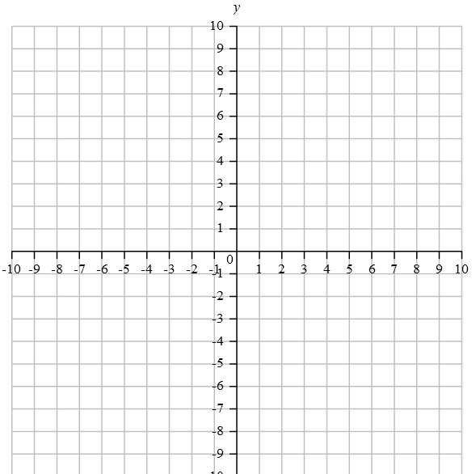
Given that the slope ${ for }_{CD}= −\frac{2}{3}$ and $B(1, −3)$, graph point $A$ so that $\left.\overline{AB}\right\|\overline{CD}$. Draw a point where you would like your answer to land. Your coordinates must have integral coordinates and land on the coordinate plane provided. After graphing your point, write the coordinates in the empty box.

Slide 5
Directions: After showing your thinking, write your answers in the boxes. You must complete both boxes. Include a negative sign, if necessary.
Write the equation of the line parallel to $y = −3x−7$ through the point $(4, 1)$. Write the slope and $y$-intercept in the boxes provided.

Slide 6
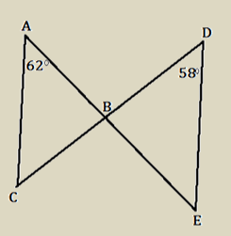
Directions: After showing your thinking, write your answer in the box.
Given that $\left.\overline{AC}\right\|\overline{DE}$, determine the $m ABC$.

Slide 7
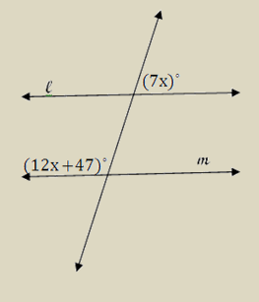
Directions: After showing your thinking, write your answer in the box. Round your answer to the nearest degree, if necessary.
Find the value of $x$, given that $\left.l\right\|m$.

Slide 8
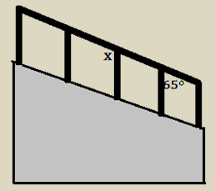
Directions: After showing your thinking, write your answer in the box.
A handrail is being added to a staircase. All the vertical poles that connect the handrail need to be perfectly parallel before the handrail is put in place. What does the angle, labeled $x$, have to measure in order to ensure that they are parallel?

Slide 9
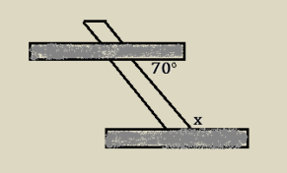
Directions: After showing your thinking, write your answer in the box.
Two shelves are being fastened to the wall using a metal bracket. In order for the shelves to be parallel, what would be the value for angle $x$?

