Slide 1
Geometry Review PPT Finnegan 2013
SOL
G.4
Constructions

Slide 2
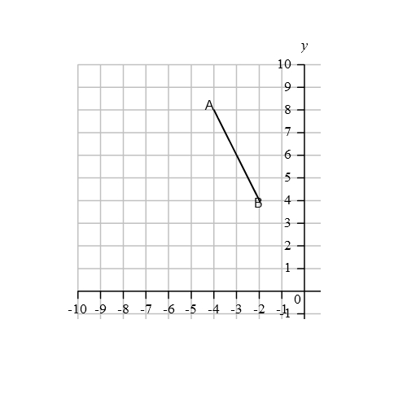
Given the endpoints $A$($−$4, 8) and $B$($−$2, 4), construct the perpendicular bisector. Then graph a point on the coordinate plane that has integer
coordinates in the range {$−$10, 0}.

Slide 3
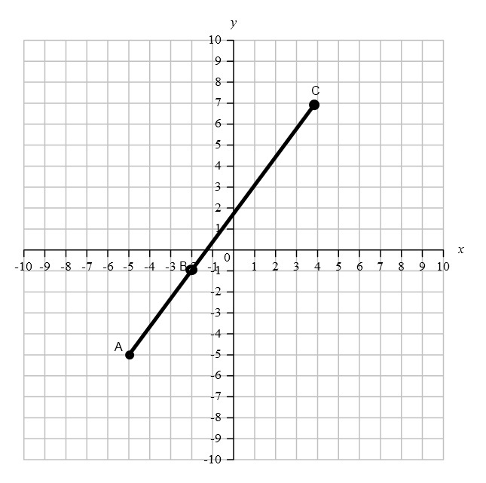
Construct a perpendicular line to $\overline{AC}$ through point $B$.

Slide 4
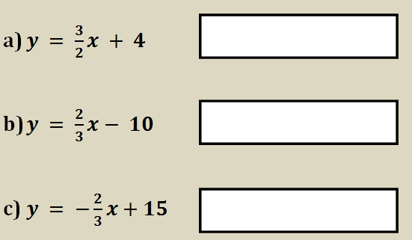
Directions: After showing your thinking, write your answer in each box. Write the word ‘parallel’, ‘perpendicular’, or ‘neither’ in each box.
Given the equation for $l_{1}$ is $2x+3y= −8$, determine for each of the following whether they are parallel to $l_{1}$, perpendicular to $l_{1}$, or neither.

Slide 5
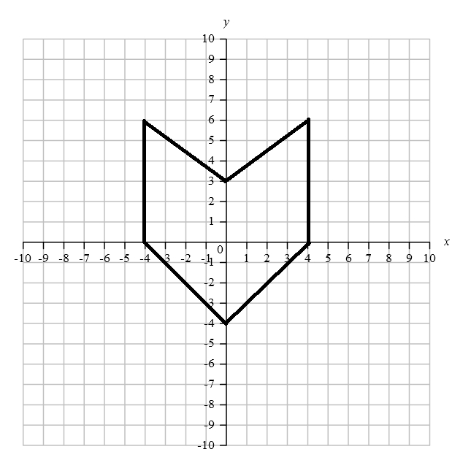
Directions: Highlight the box you want to select.
Which type of symmetry does the figure on the coordinate plane have?

Slide 6
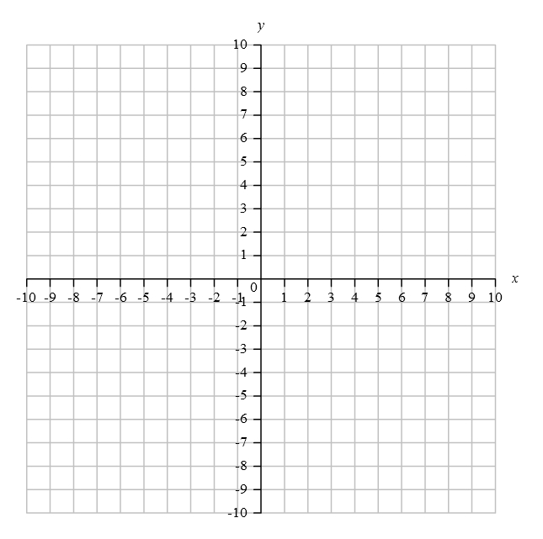
Directions: Circle the box you want to select.
Given the coordinates $K(−1, 4), L(−4, 5), M(−3, 8)$, and after the result of a transformation the coordinates $K’(4, 1), L’(5, 4), M’(8, 3)$, determine what transformation occurred.

Slide 7
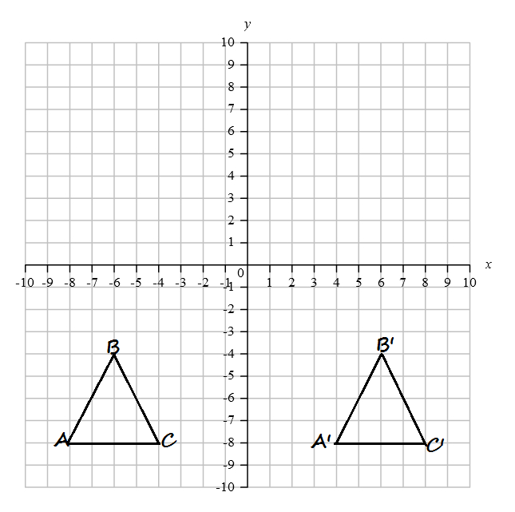
Directions: Circle the box you want to select.
A transformation mapped $ABC$ to $A’B’C’$. Which transformation occurred?

Slide 8
Directions: Circle the box you want to select. You must select all correct answers.
Select the ordered pair that would form a segment with the endpoint ($−$1, 8) that has a length 5.

Slide 9
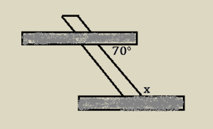
Directions: After showing your thinking, write your answer in the box.
Two shelves are being fastened to the wall using a metal bracket. In order for the shelves to be parallel, what would be the value for angle $x$?

