Slide 1
Geometry Review PPT Finnegan 2013
SOL
G.5
Triangles

Slide 2
In triangle $PQR$, $m P$ = 60°, $m Q$ = 77° and $m R$ = 43°. Order the sides of the triangle from longest to shortest. Write the sides in order in the boxes provided below. A list of the sides is shown below.

Slide 3
Directions: After showing your thinking, write your answers in the series of boxes below. You must complete each box.
$m A$ = (10$x$)°, $m B$ = ($x$²)°, and $m C$ = (21$x$)°. In $∆ABC$, order the sides from longest to shortest. Write the sides in order in the boxes provided below.

Slide 4
Right triangle $MPQ$ has acute angles $M$ and $Q$. $m M$ = (3$x$ + 9)° and $m Q$ = (4$x$ + 4)°. Order the sides of the triangle from longest to shortest. Write the sides in order in the boxes provided below.

Slide 5
Triangle $EFG$ has side lengths $EG$ = 5, $EF$ = $\sqrt{10}$ and $FG$ = $3\sqrt{2}$. Write the angles in order from greatest to least.

Slide 6
The sum of three side lengths is 174. The three lengths are represented by the following expressions (4$x$ – 8), (5$x$ + 3) and (6$x$ – 1). Find the value of $x$ and then determine whether the lengths could form a triangle.

Slide 7
A side length of 23 could be combined with what two other sides to form a triangle?

Slide 8
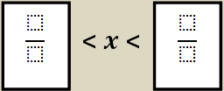
Directions: After showing your thinking, write your answers in the boxes below. Your answers should be fractions. Use improper fractions, if necessary. Do not use mixed numbers.
If two side lengths are $\frac{3}{4}$ and $\frac{5}{8}$, what are possible lengths of the third side, $x$?

Slide 9
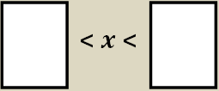
Directions: After showing your thinking, write your answers in the boxes below to complete the inequality. Your answers should be decimals to the tenths place.
Two lengths of a triangle are 1.8 and 2.9. What are the possible lengths of the third side?

Slide 10
Directions: After showing your thinking, highlight the box you want to select. You must select all correct answers.
The Bermuda Triangle connects Miami to Bermuda to Puerto Rico. If the distance from Miami to Bermuda is approximately 1,040 miles and the distance from Bermuda to Puerto Rico is approximately 970 miles, then what are possible distances from Puerto Rico to Miami (since the distance must form a triangle)?

Slide 11
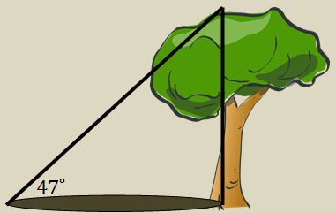
A tree and its shadow create a right triangle. The angle of elevation from the ground to the tree is 47°. Which one is longer, the height of the tree or the length of the shadow?

