Slide 1
Geometry Review PPT Finnegan 2013
SOL
G.7
Triangles

Slide 2
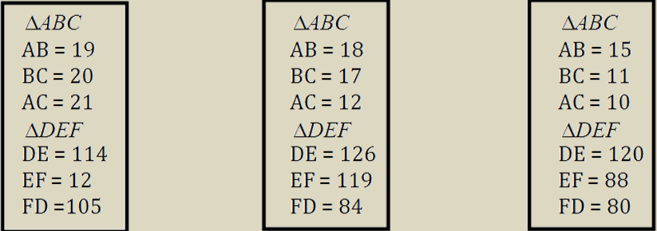
Directions: After showing your thinking, highlight the box you want to select. You must select all correct answers.
Which sets of side lengths represent triangles where $∆ABC\sim ∆DEF$ by Side-Side-Side similarity?

Slide 3
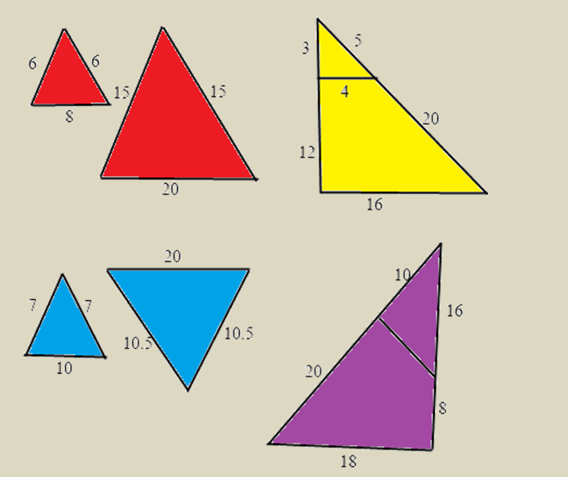
Which pair of triangles could be proven similar by Side-Side-Side similarity?

Slide 4
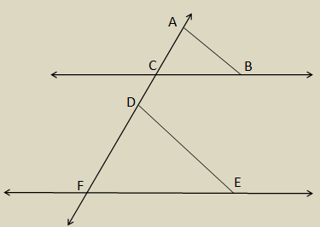
Directions: After showing your thinking, circle the box you want to select.
If $ABC≅ DEF$ and $\overset{⃡}{CB}\left\|\overset{⃡}{FE}\right.$, which method would be used to prove that $∆ACB\sim ∆DFE$?

Slide 5
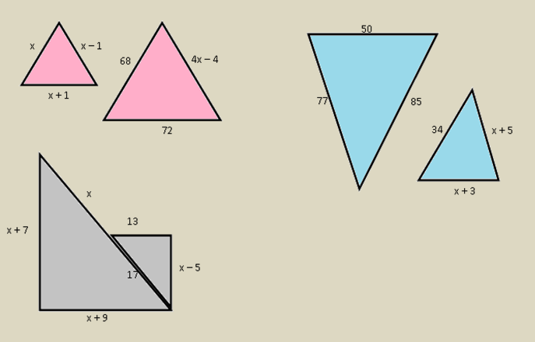
Directions: After showing your thinking, circle the pairs of triangles you want to select. You must select all correct answers. Figures not drawn to scale.
If $x$ = 17, which pairs of triangles are similar?

Slide 6
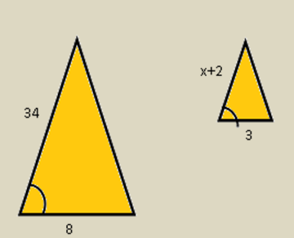
Directions: After showing your thinking, write your answer in the box as a fraction. Your answer should be an improper fraction, if necessary. Do not use mixed numbers.
In order for the triangles in the diagram to be similar by Side-Angle-Side, the sides must be in proportion. Use proportions to solve for the value of $x$.

Slide 7
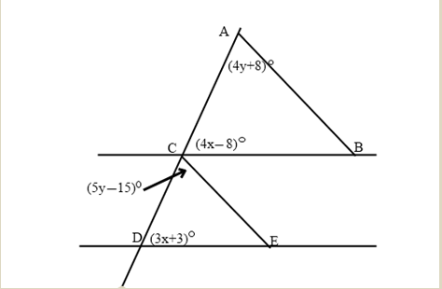
Directions: After showing your thinking, write your answer in the boxes provided.
In order for $∆ACB\sim ∆CDE$, what are the values for $x$ and $y$?

Slide 8
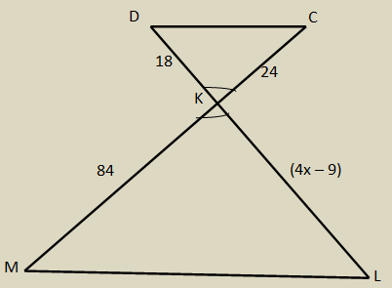
Directions: After showing your thinking, write your answers in the boxes provided.
Find the value of $x$ and then find the length of KL in order for $∆DKC\sim ∆LKM$.

Slide 9
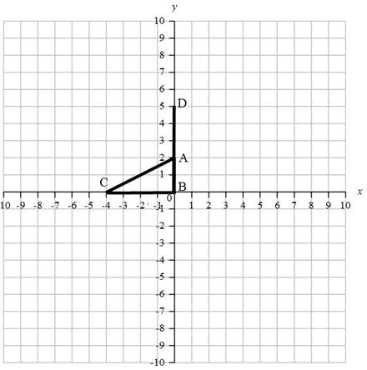
Find the coordinates for $E$, so that $∆ABC\sim ∆DBE$ if $A$(0, 2), $B$(0, 0), $C$($−$4, 0), and $D$(0, 5).

