Slide 1
Geometry Review PPT Finnegan 2013
SOL
G.8
Triangles

Slide 2
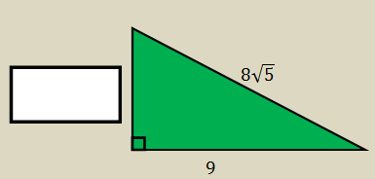
Directions: After showing your thinking, write your answer in the box. Your answer should be in simplest radical form.
Determine the length of the missing leg in the right triangle shown.

Slide 3
If one of the sides of a right triangle has a distance of 18 units, what are the possibilities for the other two sides?

Slide 4
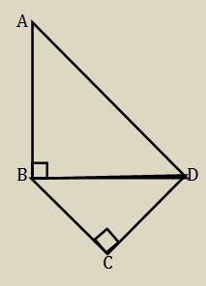

Slide 5
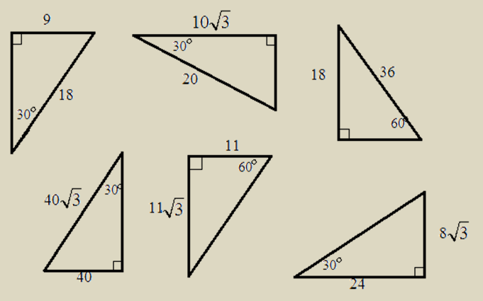
Circle all the correct answers.
Which triangles correctly label the relationship of the sides in a 30°-60°-90° triangle?

Slide 6
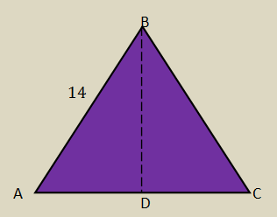
Directions: After showing your thinking, write your answer in the box. Your answer should be in simplest radical form.
$\overline{BD}$ is an altitude and an angle bisector in $∆ABC$. If $m ABC = 60°$ and $\overline{AB}$ = 14, find the length of the altitude $\overline{BD}$.

Slide 7
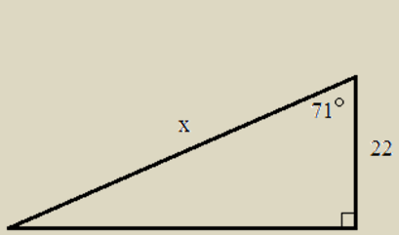
Directions: After showing your thinking, write your answer in the box. Round your answer to the nearest tenth.
Solve for $x$.

Slide 8
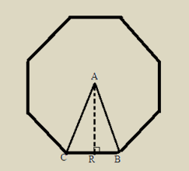
Directions: After showing your thinking, write your answer in the box. Round your answer to the nearest tenth.
In this regular octagon, $∆CAB$ has $\overline{AR}$ as an altitude and angle bisector. If $AB = 17$, find $AR$.

Slide 9
Directions: After showing your thinking, write your answer in the box. Round your answer to the nearest degree.
If the rise of a set stairs is 6 feet and the length of the stairs is 5 feet, what is the angle elevation of the staircase (the angle labeled $x$)?

Slide 10
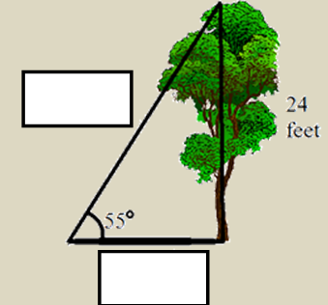
Directions: After showing your thinking, write your answer in the boxes. You should use the possible answers provided in the shaded box.
A tree, 24 feet tall, forms a shadow on the ground, where the angle of elevation is 55°. What is the length of the tree’s shadow? What is the distance from the tree top to the end of the shadow?

Slide 11
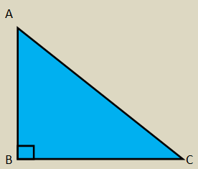
Directions: After showing your thinking, write your answer in the box. Your answer should be a fraction.
If the $\cos{A}= \frac{15}{17}$, what is the $\sin{A}$?

