Slide 1
Geometry Review PPT Finnegan 2013
SOL
G.9

Slide 2
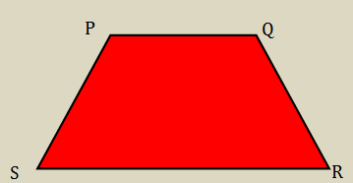
In trapezoid $PQRS$, $\overline{PS} ≅ \overline{QR}$ and $m P = 110°$. Select all the true statements that can be concluded based on this information.

Slide 4
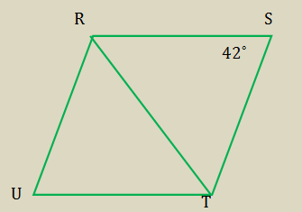

Slide 5
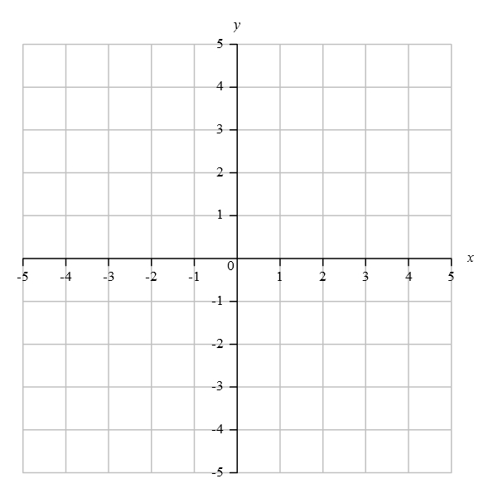
Directions: Graph the point. Then, write the ordered pair of your point in the box.
Three coordinates of quadrilateral $PQRS$ are the following $P(−2, 2)$, $R(5, −4)$, and $S(1, −5)$. Graph point $Q$ so that $PQRS$ is a parallelogram.

Slide 6
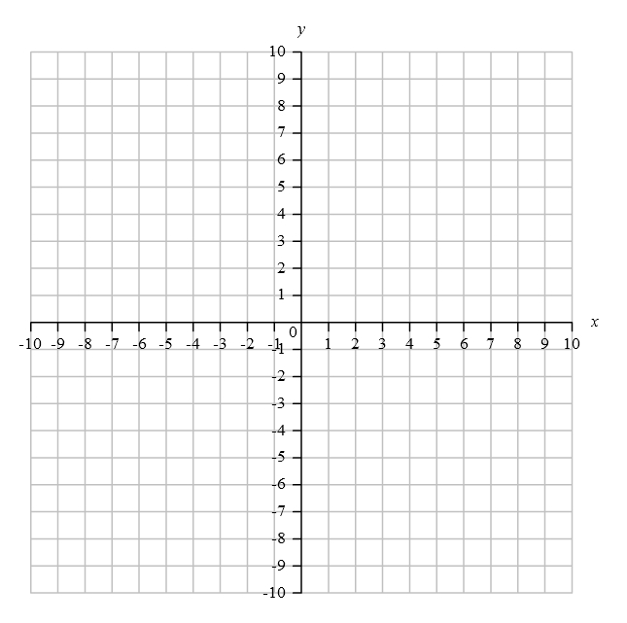
Directions: Write your answer in the box.
Quadrilateral $CDEF$ has the following vertices: $C(5, 4)$, $D(1, 1)$, $E(5, −2)$, and $F(9, 1)$. In order for the quadrilateral to be a rhombus, the sides must all be equal. Find the length of the sides.

Slide 7
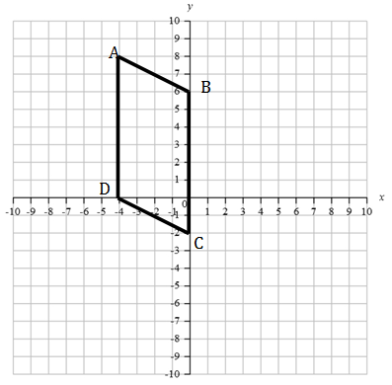
A quadrilateral $ABCD$ has the following vertices $A(−4, 8)$, $B(0, 6)$, $C(0, −2)$ and $D(−4, 0)$. Find the midpoint of the diagonals, $E$, so that $\overline{BE} ≅ \overline{ED}$ and $\overline{AE} ≅ \overline{EC}$, then graph that point on the coordinate plane and write the ordered pair in the box.

Slide 8
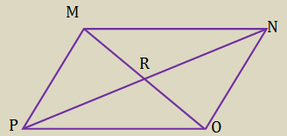
Directions: Highlight the box you want to select. You must select all correct answers.
Which are sufficient to prove that $MNOP$ is a parallelogram?

Slide 9
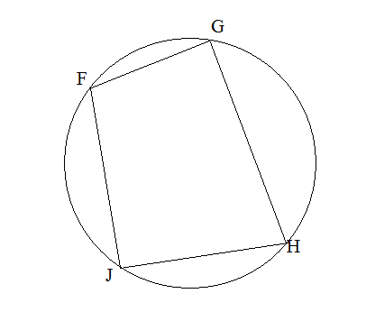
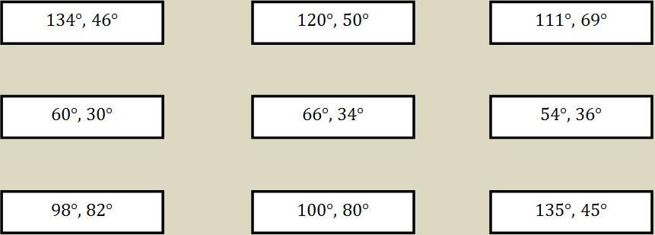

Slide 10
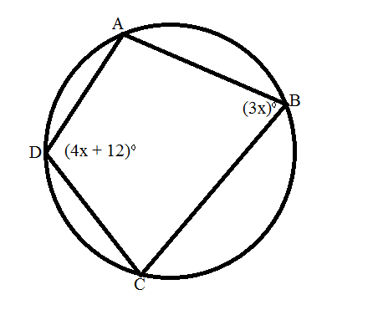
Quadrilateral $ABCD$ is inscribed in a circle. Find the value of $x$.

Slide 11
