Slide 1
GRUDGE BALL
S1 REVIEW
© Classroom Ms. Fit, 2016

Slide 2
SET-UP DIRECTIONS
Set up trash can basket. I divide the room, or clear a space to create a shooting range. I place two markers on the ground for 2 point and 3 point goals. I use squishy balls or paper balls to shoot the hoops.
Name/number each team. I have assigned names or numbers to groups, and I have also let them choose a name; often times it is more beneficial for time’s sake to choose for them. The game is designed for 6 teams total. Personally, four or five groups of three to five students has worked best for me. I bumped it to six to accommodate larger class sizes; or delete/move slides to fit the needs of your smaller class. I have used extra slides as bonus questions many times in the past.
Each team receives 15 points to begin. I have used x’s, or bars, to represent the number of points. I place these points such that they are easily visible to all students; usually on the white board in the front of class. I will draw dividers between each team, and their points, so no mistakes are made. Students will need to get to these points easily as they will be responsible for erasing points.
Give teams one whiteboard, or make sure they have space to write on a mounted whiteboard. This is essential! I DO NOT accept answers that are yelled out to me, or answers that I cannot read. This eliminates the, “you didn’t hear me right” or “you didn’t read my answer right” arguments. Have students select a group scribe, to write all answers on the given whiteboard.
Give each student an answer document. All students are responsible for answering each question, even if it is not specific to their group. This is needed both for purposes of the game, and it gives me an opportunity to look over their work to see if extra practice or remediation is needed.
STOP!
© Classroom Ms. Fit, 2016

Slide 3
GAME DIRECTIONS
Each team will start with 15 points. The team with the most points left at the end of the game wins.
Each team will have a specific question to answer in two minutes. All teams will work on the same question. Work will be shown on the answer document provided.
If the first answer is incorrect, the team has the remaining time to come up with the correct answer.
At the end of two minutes, students must put all dry erase markers down.
The answer MUST be written on the whiteboard, and it must be legible, or it will be considered wrong. There will be NO time given to rewrite an answer.
If the answer is correct the team will be awarded 2 TAKE DOWN points from any team(s) they like. Example: two points could be taken from one team, or one point could be taken from two teams.
The team can then designate a shooter, or rotate shooters, for the opportunity to earn up to three more TAKE DOWN points. If the basket is missed, no points are awarded or taken. If the basket is made, the team will be awarded two, or three, TAKE DOWN points to remove using the guidelines stated above.
STOP!
DIRECTIONS CONTINUED ON NEXT SLIDE…..
© Classroom Ms. Fit, 2016

Slide 4
GAME DIRECTIONS
If the final answer is incorrect the following teams, in numerical/team order, will have an opportunity to answer.
In order to answer, the the team must “buy-in” by giving up two of their own points. Teams not willing to buy-in cannot answer, and the following team will have an opportunity to buy-in and answer. If no team buys-in, then it is assumed no one understands the problem and it will be discussed as a class.
Teams should not be afraid to buy-in, many teams have won using this strategy.
If a team buys-in, and the answer is correct, the point and shooting rules apply as stated before. Points will not be added back to their own team. TAKE DOWN points can only be used to take points away from other teams.
If a team buys-in, and the answer is incorrect, no TAKE DOWN points are awarded and the team cannot shoot for points.
Once the question is answered, or reviewed as a class, the following question goes to the next team in slide order; even if it was a team that bought in on the previous question.
A team out of points can regain by answering their next question correct. Max points back is two. Additional points, after shooting, are for taking away from other teams only.
STOP!
© Classroom Ms. Fit, 2016
GOOD LUCK!!

Slide 5
TEAM: 1 QUESTIONS: GROUP A
Could the following side lengths create a right triangle? Explain your reasoning mathematically.
10 cm., 24 cm., and 26 cm.
STOP!
© Classroom Ms. Fit, 2016

Slide 6
Yes! This can be proven by using Pythagorean Theorem.
OR
This can also be proven by noticing the primitive Pythagorean triple multiplied by 2.
5, 12, 13 10, 24, 26
STOP!
© Classroom Ms. Fit, 2016

Slide 7
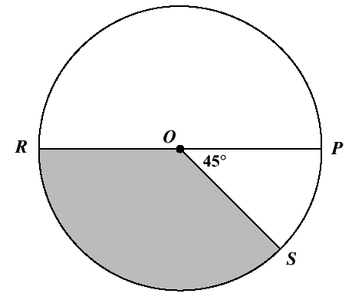
TEAM: 2 QUESTIONS: GROUP A
Find the EXACT value of the missing side length. Explain your reasoning mathematically.
Answer must be in terms of pi.
STOP!
© Classroom Ms. Fit, 2016

Slide 8
The missing side length can be found by using Pythagorean Theorem and leaving the result in simplest radical form.
OR
Since this is a right triangle, you can also use the given side lengths as clues to a pattern. This is a 30, 60, 90 triangle; so, the pattern is a, 2a, a$\sqrt{3}$
$$°$$
$$°$$
$$°$$
STOP!
© Classroom Ms. Fit, 2016

Slide 9
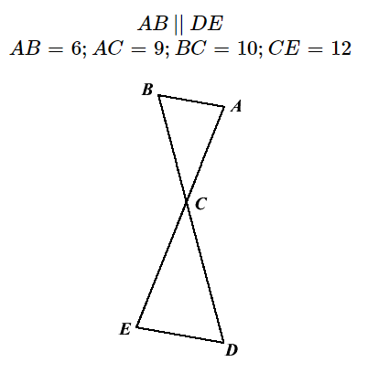
TEAM: 3 QUESTIONS: GROUP A
Find the EXACT values of the missing side lengths x and y. Explain your reasoning mathematically.
STOP!
© Classroom Ms. Fit, 2016

Slide 10
These can be found using Pythagorean Theorem.
OR
These can be found using a special right triangle pattern. This is a 45, 45, 90 triangle; so, the pattern is a, a, a$\sqrt{2}$
$$°$$
$$°$$
$$°$$
STOP!
© Classroom Ms. Fit, 2016

Slide 11
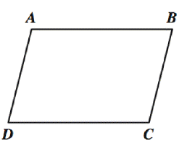
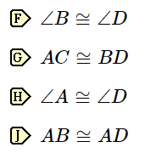
TEAM: 4 QUESTIONS: GROUP A
Find the values of the missing side lengths. Explain your reasoning mathematically.
If needed, round answers to the nearest hundredth.
60$°$
STOP!
© Classroom Ms. Fit, 2016

Slide 12
These can be found using the 30, 60, 90 triangle pattern; a, a, a$\sqrt{3}$.
OR
These can be found using trigonometry; SOH-CAH-TOA.
$$°$$
$$°$$
$$°$$
$$°$$
STOP!
© Classroom Ms. Fit, 2016

Slide 13
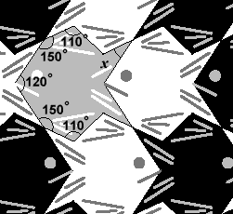
TEAM: 5 QUESTIONS: GROUP A
Find the values of the missing side lengths x and y. Explain your reasoning mathematically.
If needed, round answers to the nearest hundredth.
STOP!
© Classroom Ms. Fit, 2016

Slide 14
These can be found using trigonometry; SOH-CAH-TOA.
STOP!
© Classroom Ms. Fit, 2016

Slide 15
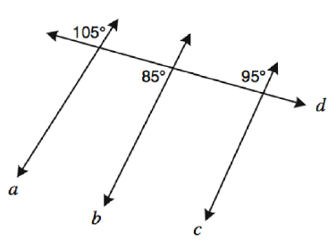
TEAM: 6 QUESTIONS: GROUP A
Find the value of the missing angle. Explain your reasoning mathematically.
Round your answer to the nearest whole number.
STOP!
© Classroom Ms. Fit, 2016

Slide 16
The missing angle can be found by using special right triangles; this is a 30 , 60, 90 triangle based on the side lengths.
OR
You can use an inverse trigonometry function.
$$°$$
$$°$$
$$°$$
STOP!
© Classroom Ms. Fit, 2016

Slide 17
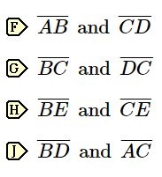
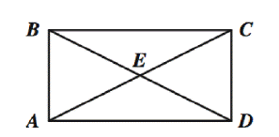
TEAM: 1 QUESTIONS: GROUP B
Find the altitude of the isosceles triangle.
Round your answer to the nearest hundredth if needed.
STOP!
© Classroom Ms. Fit, 2016

Slide 18
The altitude can be found by using trigonometry.
STOP!
© Classroom Ms. Fit, 2016

Slide 19
TEAM: 2 QUESTIONS: GROUP B
Find the perimeter of the isosceles triangle.
Round your answer to the nearest hundredth if needed.
STOP!
© Classroom Ms. Fit, 2016

Slide 20
The missing sides can be found by using trigonometry.
20 in.
52$°$
STOP!
© Classroom Ms. Fit, 2016

Slide 21
TEAM: 3 QUESTIONS: GROUP B
What is the area of the
Rectangle?
Find the area of the rectangle.
Round your answer to the nearest hundredth if needed.
12 in.
22$°$
STOP!
© Classroom Ms. Fit, 2016

Slide 22
The missing sides can be found by using trigonometry.
12 in.
4.50 in.
22$°$
Area = 50.09 in.
11.13 in.
STOP!
© Classroom Ms. Fit, 2016

Slide 23
TEAM: 4 QUESTIONS: GROUP B
The area of the square is 64. What numbers go in the boxes to give the length of the diagonal?
The area of the square is 36 ${in}^{2}$. What is the length of the diagonal?
Round your answer to the nearest hundredth if needed.
x
STOP!
© Classroom Ms. Fit, 2016

Slide 24
Once you find the sides of the square using the area, you can use trigonometry, special right triangles or Pythagorean theorem.
$$\sqrt{2}$$
6
STOP!
© Classroom Ms. Fit, 2016

Slide 25
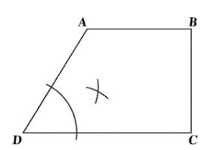
TEAM: 5 QUESTIONS: GROUP B
What is the altitude of the rhombus?
Round your answer to the nearest hundredth if needed.
STOP!
© Classroom Ms. Fit, 2016

Slide 26
The altitude can be found using trigonometry.
STOP!
© Classroom Ms. Fit, 2016

Slide 27
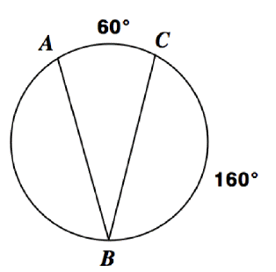
TEAM: 6 QUESTIONS: GROUP C
The perimeter of the equilateral triangle is 9 in., what is the area of the triangle?
Round your answer to the nearest hundredth if needed.
STOP!
© Classroom Ms. Fit, 2016

Slide 28
After finding the side lengths of the triangle, you can use Pythagorean theorem, special right triangles, or trigonometry to find the altitude.
You will then use the altitude to find the area of the triangle.
$${in}^{2}$$
STOP!
© Classroom Ms. Fit, 2016

Slide 29
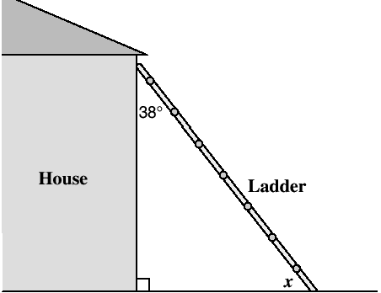
TEAM: 1 QUESTIONS: GROUP C
STOP!
© Classroom Ms. Fit, 2016

Slide 30
The length of the ladder can be found using special right triangles or trigonometry.
STOP!
© Classroom Ms. Fit, 2016

Slide 31
TEAM: 2 QUESTIONS: GROUP C
What is the angle of elevation, of the top of a building, as you stand 400ft away from the base and are looking up to the top of a building; which stands at 850 ft tall. (Remember: elevation means looking up from a parallel)
Round your answer to the nearest whole number.
STOP!
STOP!
© Classroom Ms. Fit, 2016

Slide 32
Use inverse trigonometry to find the angle of elevation.
STOP!
© Classroom Ms. Fit, 2016

Slide 33
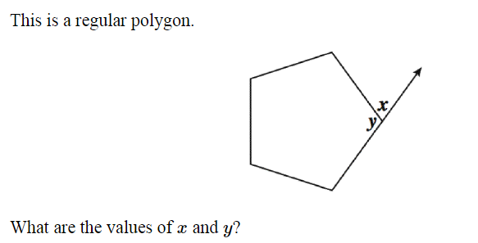
TEAM: 3 QUESTIONS: GROUP C
You are planning to build a 16 ft. ramp with a max height of 2 ft. What is the approximate horizontal distance needed to properly construct the ramp?
Round your answer to the nearest hundredth.
STOP!
© Classroom Ms. Fit, 2016

Slide 34
You can use Pythagorean theorem to find the approximate horizontal distance.
STOP!
© Classroom Ms. Fit, 2016

Slide 35
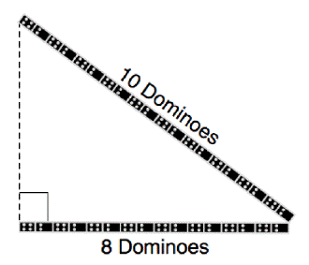
TEAM: 4 QUESTIONS: GROUP C
You are in a hot air balloon 450 ft above a point on the ground. You see your friend standing at the launch site, 700 ft from the point directly below the balloon you’re riding in. What is the angle of depression, of your line of sight, as you look at your friend to wave hello?
Round your answer to the nearest whole number.
STOP!
© Classroom Ms. Fit, 2016

Slide 36
You can use inverse trigonometry to find either angle in the triangle made by the balloon, height of the balloon and launch site. Use that angle to find the angle of depression.
STOP!
© Classroom Ms. Fit, 2016

Slide 37
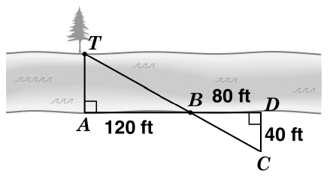
TEAM: 5 QUESTIONS: GROUP C
You are standing 300 ft directly below a fireworks display. The noise becomes over bearing and you decide to run back to where your family is watching, 500 ft away. What will be the angle of your view to watch the fireworks once you are back with your family?
Round your answer to the nearest whole number.
STOP!
© Classroom Ms. Fit, 2016

Slide 38
You can use inverse trigonometry to find the angle of your view, which is the angle of elevation.
STOP!
© Classroom Ms. Fit, 2016

Slide 39
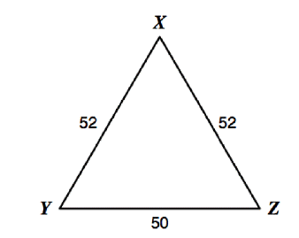
TEAM: 6 QUESTIONS: GROUP C
STOP!
© Classroom Ms. Fit, 2016

Slide 40
You can use trigonometry to find the length of the line, which is just the hypotenuse of the triangle made.
STOP!
© Classroom Ms. Fit, 2016

Slide 41
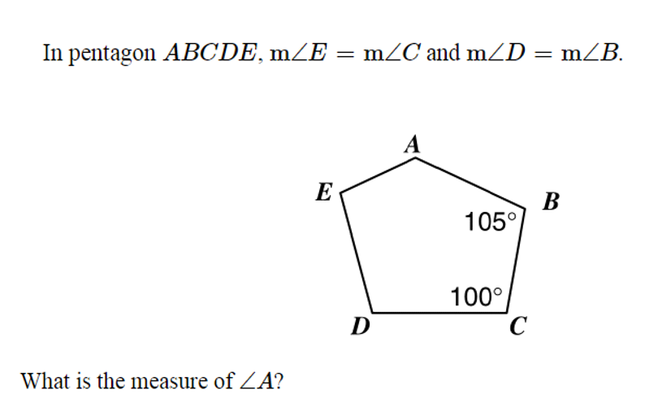
TEAM: 6 QUESTIONS: GROUP C
STOP!
© Classroom Ms. Fit, 2016

Slide 42
You can use trigonometry to find the length of the line, which is just the hypotenuse of the triangle made.
STOP!
© Classroom Ms. Fit, 2016

Slide 43
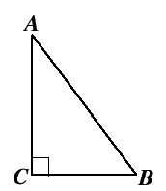
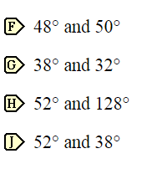
TEAM: 6 QUESTIONS: GROUP C
STOP!
© Classroom Ms. Fit, 2016

Slide 44
You can use trigonometry to find the length of the line, which is just the hypotenuse of the triangle made.
STOP!
© Classroom Ms. Fit, 2016

Slide 45
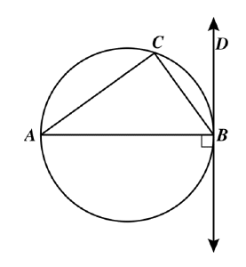
TEAM: 6 QUESTIONS: GROUP C
STOP!
© Classroom Ms. Fit, 2016

Slide 46
You can use trigonometry to find the length of the line, which is just the hypotenuse of the triangle made.
STOP!
© Classroom Ms. Fit, 2016

Slide 47
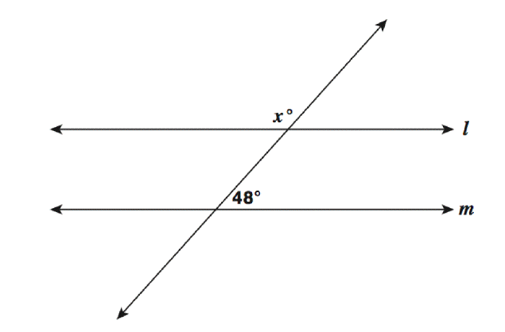
TEAM: 6 QUESTIONS: GROUP C
STOP!
© Classroom Ms. Fit, 2016

Slide 48
You can use trigonometry to find the length of the line, which is just the hypotenuse of the triangle made.
STOP!
© Classroom Ms. Fit, 2016

Slide 49
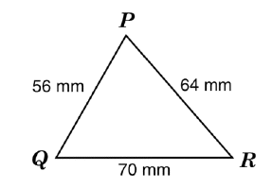
TEAM: 6 QUESTIONS: GROUP C
STOP!
© Classroom Ms. Fit, 2016

Slide 50
You can use trigonometry to find the length of the line, which is just the hypotenuse of the triangle made.
STOP!
© Classroom Ms. Fit, 2016

Slide 51
TEAM: 6 QUESTIONS: GROUP C
STOP!
© Classroom Ms. Fit, 2016

Slide 52
You can use trigonometry to find the length of the line, which is just the hypotenuse of the triangle made.
STOP!
© Classroom Ms. Fit, 2016

Slide 53
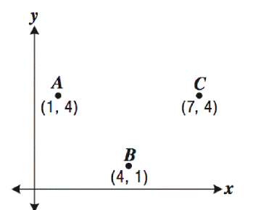
TEAM: 6 QUESTIONS: GROUP C
STOP!
© Classroom Ms. Fit, 2016

Slide 54
You can use trigonometry to find the length of the line, which is just the hypotenuse of the triangle made.
STOP!
© Classroom Ms. Fit, 2016

