Slide 1
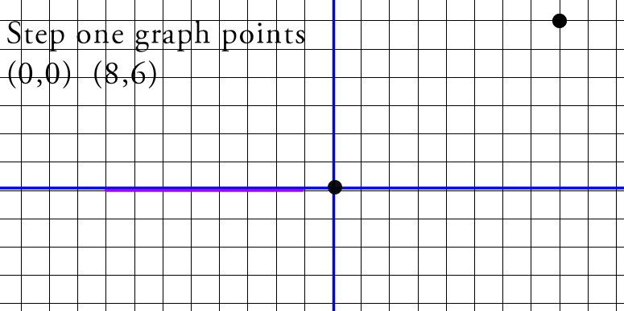

Slide 2
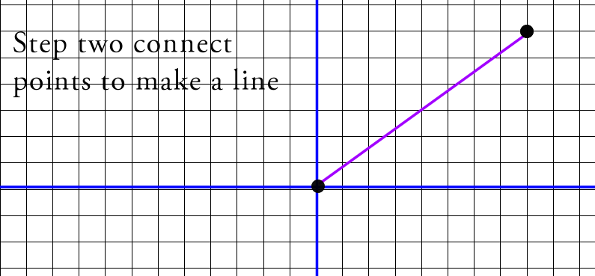

Slide 4
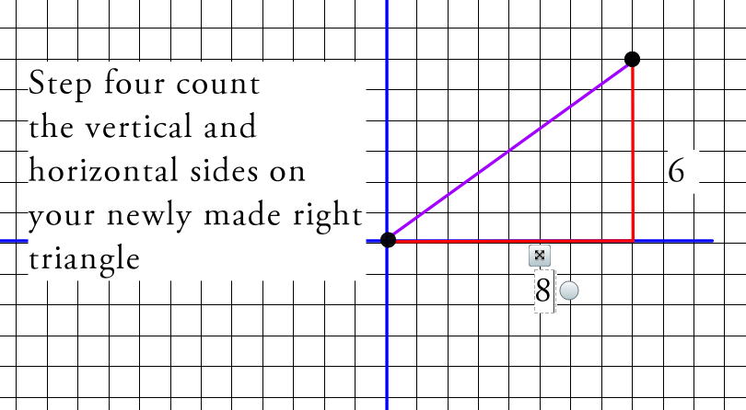

Slide 5
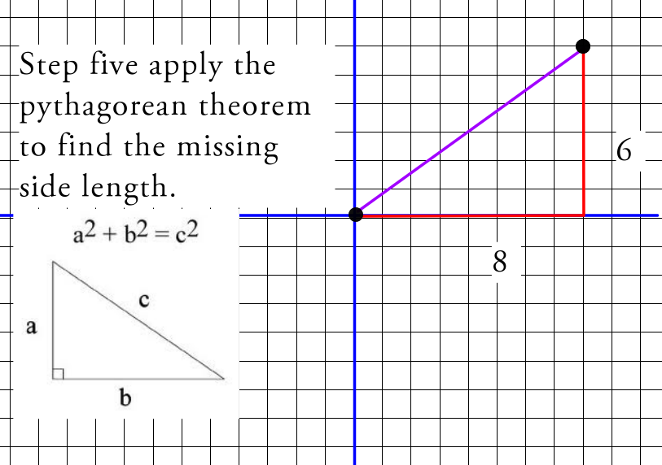

Slide 6
a^2 + b^2 = c^2 6^2 + 8^2 = c^2 36 + 64 = c^2 100 = c^2 take the square root of both sides to get c 10 = c therefore the distance/length is 10

Slide 7
Finding endpoint when you have a midpoint and an endpoint
Endpoint (0,0) Midpoint (5,3) Find missing endpoint x+x , y+y 2 2 0+x =5 0+y= 3 2 2 multiply both sides of each equation by 2 0+x = 10 0+y =6 x=10 y=6 The missing endpoint is at (10,6)

